Slide 1
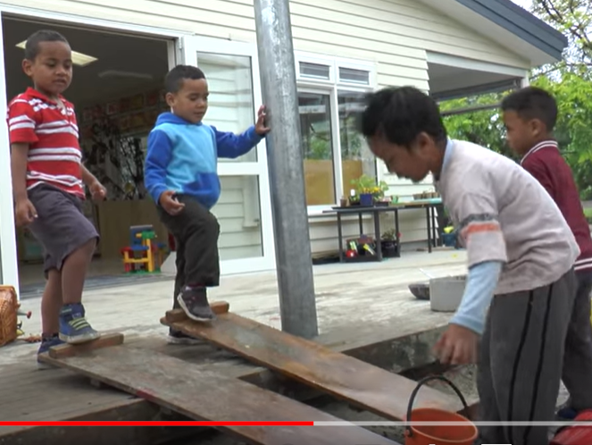
Workshop 6 Assessment and Learning Dispositions Rise at Manchester Met (mmu.ac.uk)

Slide 2
Learning Outcomes for the workshop
Critically evaluate the relationship between policy on assessment in New Zealand and the potential impact on children’s learning dispositions.
Summarise the challenges of school readiness
Notes:
Building on last week we are looking at how the way that we construct our expectations of young children is more or less limiting for creating the environment in which children develop. The case studies of assessment from New Zealand are interesting in style and conent in creating a positive identity for the child

Slide 3
New Zealand’s Te Whāriki curricuculum
New Zealand’s Te Whāriki is a progressive and cogent document regarding the orientation and aims of ECE. The document clearly lays out what is expected from staff and child development with useful examples. The curriculum provides continuous child development through the use of one national framework for ECE; putting the community at the centre of the curriculum; strongly focusing on well-being and learning; ensuring age-appropriate content; emphasising the importance of tolerance and respect for cultural values and diversity; and aligning the ECE curriculum with primary schooling. OECD 2012 p7
http://dx.doi.org/10.1787/9789264176690-en

Slide 4
Deciding what matters here (education.govt.nz)

Slide 5
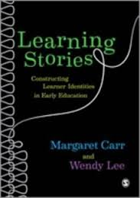
An alternative style of assessment;
learning stories from New Zealand (Lee and Carr)
Developing personal narratives
Connecting experiences across time
Developing personal reflection
Engaging in dialogue
Developing learning dispositions
Are there dangers with this approach?
Notes:
Read some of the case study learning stories from Carr and Lee’s book be ready to say in what ways you think this type of learning story might be helpful and to whom?
Why are the stories addressed to the child?
Learning stories deliberately seek to promote a cognitive self-awareness of positive personal attributes and achievements. They are not just assessments they are significant part of the pedagogy of the te Whariki approach.

Slide 6
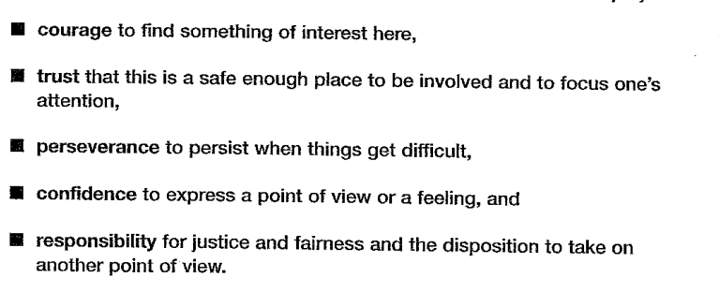
An alternative style of assessment;
learning stories from New Zealand (Lee and Carr)
Notes:
Read some of the case study learning stories from Carr and Lee’s book be ready to say in what ways you think this type of learning story might be helpful and to whom?
Why are the stories addressed to the child?
Learning stories deliberately seek to promote a cognitive self-awareness of positive personal attributes and achievements. They are not just assessments they are significant part of the pedagogy of the te Whariki approach.

Slide 8
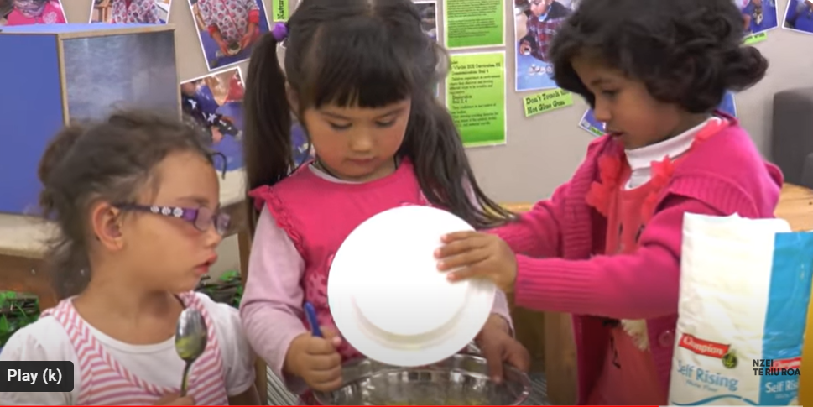
Try making a learning story for Jackson
A Morning at Kindergarten – YouTube

Slide 9
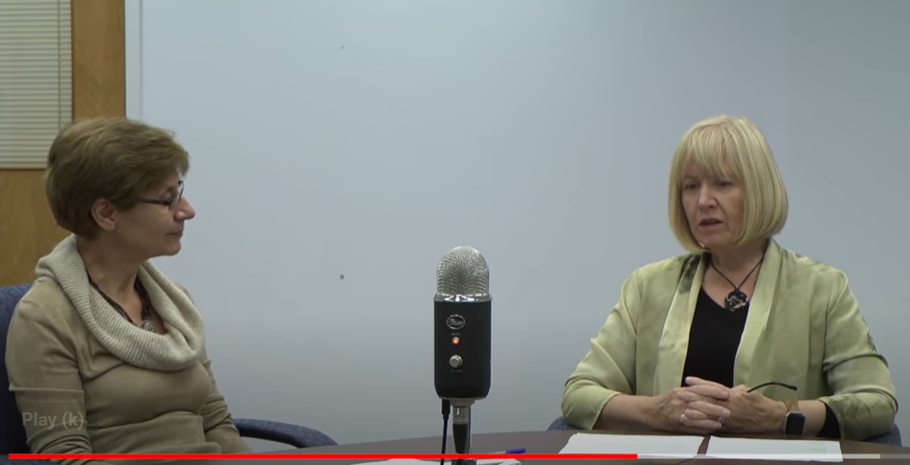
Wendy Lee
Part One: Learning Stories - a philosophical approach - YouTube

Slide 10
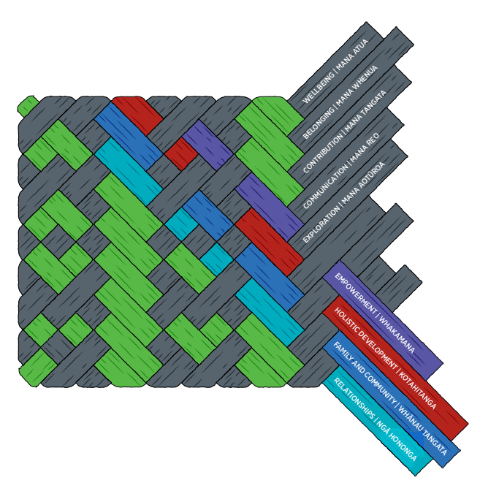
ELS-Te-Whariki-Early-Childhood-Curriculum-ENG-Web.pdf (education.govt.nz)
Te Whariki
Aromatawai^Assessment (education.govt.nz)

Slide 11
Carr el al 2002
Learning and teaching stories: Action research on evaluation in early childhood in Aotearoa-New Zeal (tandfonline.com)

Slide 12
Review

Slide 13
References
Carr, M. & Lee, W.(2012) Learning Stories Constructing Learner Identities in the Early Years. London: Sage
Margaret Carr, Helen May, Valerie N. Podmore, Pam Cubey, Ann Hatherly & Bernadette Macartney (2002) Learning and teaching stories: Action research on evaluation in early childhood in Aotearoa-New Zealand, European Early Childhood Education Research Journal, 10:2, 115-125, DOI: 10.1080/13502930285208991
OECD (2012), Quality Matters in Early Childhood Education and Care: New Zealand 2012, OECD Publishing. http://dx.doi.org/10.1787/9789264176690-en

