Slide 1
Promoting children’s creativity
WorkShop 5
Rise at Manchester Met (mmu.ac.uk)

Slide 2
Current Thinking on young children’s learning
Froebel Trust | Slow pedagogy
The video from the Froebel features Alison Clarke whose work together with Peter Moss has consistently argued that children need to be treated with greater respect and the wishes and choices respected and developed. In this recent video, Clarke discusses Slow Pedagogy as an alternative to potentially harmful conceptions of school readiness.
What is problematic about the concept of School Readiness?
What is Slow Pedagogy?
Identify and bullet point the problems associated with School Readiness.
Identify and bullet point the features of Slow Pedagogy and how they address the problems associated with School Readiness.

Slide 3
Starting Strong New Zealand (Taguma, Litjens and Makowieck 2012. p17)
Research shows that children are more competent and creative across a range of cognitive areas when they are given the choice to engage in different well-organised and age appropriate activities (CCL, 2006).
A curriculum can stimulate this behaviour through including cross-disciplinary learning activities that trigger children’s curiosity, or adopting a framework which primarily encourages cross-disciplinary rather than subject-specific learning areas or goals.
Notes:
In order to develop a framework to for critique of the Kindergarten standard for Kazakhstan Taguma et all analysis of how policy documents can influence practice was very helpful in generating a number of criteria that could be looked for in the policy documents of a country of local institution in terms of pedagogical approaches. The first criteria identified if choice in cross disciplinary context.
In the case of Kazakhstan the documentation permitted cross curricular approaches but the prescription of set hours for subjects was often manifested as subject based lessons in practice.

Slide 4
Starting Strong New Zealand (Taguma, Litjens and Makowieck 2012. p17)
Implementing such activities in small groups can encourage greater autonomy
(Eurydice, 2009; Laevers, 2011) and provides more space for spontaneous or emergent learning (NIEER, 2007). Children’s participation is not only important in order to facilitate effective learning of different curriculum elements but can be important in its own right and foster democratic values.
Notes:
In order to develop a framework to for critique of the Kindergarten standard for Kazakhstan Taguma et all analysis of how policy documents can influence practice was very helpful in generating a number of criteria that could be looked for in the policy documents of a country of local institution in terms of pedagogical approaches. The first criteria identified if choice in cross disciplinary context.
In the case of Kazakhstan the documentation permitted cross curricular approaches but the prescription of set hours for subjects was often manifested as subject based lessons in practice.

Slide 6
The Reggio Emilia approach (Italy)- Loris Malaguzzi
The program is based on the principles of respect, responsibility, and community through exploration and discovery in a supportive and enriching environment based on the interests of the children through a self-guided curriculum in the form of projects
Children must have some control over the direction of their learning;
Children must be able to learn through experiences of touching, moving, listening, and observing;
Children have a relationship with other children and with material items in the world that children must be allowed to explore;
Children must have endless ways and opportunities to express themselves.
Teacher listen, observe, provide experiences and explore ideas with children
Community involvement and participation in community are crucial to Reggio

Slide 7
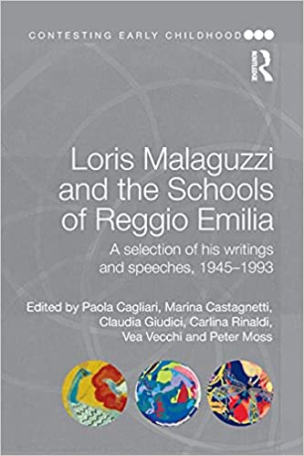
Reggio Emilia; Boulogne Italy
Led by Loris Mallaguzzi following WWII to promote independent thinking, children’s voice, creativity.
https://www.youtube.com/watch?v=xaMHusQjvV8
Develops children’s project ideas
Develops children’s observational and process skills through artist guides.
Gives space and time to develop projects.
https://www.reggiochildren.it/en/reggio-emilia-approach/timeline-en/

Slide 8
Smidt, S. (2013) Introducing malaguzzi : exploring the life and work of reggio emilia's founding father. Milton Park, Abingdon, Oxon: Routledge.
How are the principles outlined above realised in practice?
What is the role of the pedagogisti in supporting children’s learning?
How are projects developed with the children and what do Atelierista’s do?
What is the nature of the learning environment?
From Reggio Emilia to West Midlands - YouTube

Slide 9
References
Smidt, S. (2013) Introducing Malaguzzi : exploring the life and work of Reggio Emilia's founding father. Milton Park, Abingdon, Oxon: Routledge.
Taguma, Litjens and Makowieck (2012) Starting Strong New Zealand ; New York: OECD online available at Quality Matters in Early Childhood Education and Care: New Zealand 2012 | Quality Matters in Early Childhood Education and Care | OECD iLibrary (oecd-ilibrary.org)
Accessed 05/12/23

