Slide 1
Firm Foundations School Readiness
Dr Martin Needham
M.Needham@mmu.ac.uk

Slide 2
Overview of School Readiness sessions
Rise at Manchester Met (mmu.ac.uk)
Activity 1.
Week 1 What is school readiness? Preparation for school by being controlled, independent, communicative or Starting school early and Schools being ready to be inclusive destinations.
Week 2 Parents and Children together -Supporting Authoritative Parenting - example Martenscroft Stay and Play
Week 3 Play and Child led learning- What is play and why is it so good for children? Example Evaluation of play resources at Martenscroft
Week 4 Plan Do Review- Drawing attention to learning- encouraging children to set targets and evaluate them developing time management. Example Highscope Approach, USA
Week 5 Creativity- exploring materials, solving problems, developing storylines, Slow Learning –Time Example Regio Emilia Italy
Week 6 Assessment and dispositions Celebrating what children can do and sharing learning stories with children and parents. Example Te Wharikki New Zealand

Slide 3
Outline of today’s workshop
Our Purposes of today
To examine parental influence on school readiness
To be able to identify some key principles for working with parents as children’s first educators.
To examine and evaluate the evidence and arguments for different types of parental support.
To identify key elements of theories of sociocultural learning and shared thinking
Activity 1.
Activity Week 1 Interview with Head of Martenscroft Children’s Centre on school readiness for families
Activity 2. Baumrinds Parenting Styles
Activity 3.Supporting learning interactions
Activity 4. Supporting Parents wellbeing

Slide 4
Supporting children and families 0-4
Interview with Debbie Keary from Martenscroft Children’s centre
https://stummuac-my.sharepoint.com/:v:/r/personal/55113224_ad_mmu_ac_uk/Documents/School%20Readiness/Stay%20and%20Play%20Q%20%26%20A-20231110_103841-Meeting%20Recording.mp4?csf=1&web=1&e=b055rd

Slide 5
Rise at Manchester Met (mmu.ac.uk)

Slide 6
Parenting Styles
Authoritative; Permissive; Authoritarian; Indifferent.
“Within the authoritative model, behavioral compliance and psychological autonomy are not viewed as mutually exclusive but rather as interdependent objectives: children are encouraged to respond habitually in prosocial ways and to reason autonomously about moral problems, and to respect adult authorities and to learn how to think independently” (Baumrind 1996: 405) .
What are your views on attitudes to parenting, to what extent would you agree that attitudes are changing? Discuss with your group.
Notes:
This idea of parenting styles is very pervasive in regard to supporting social and emotional development. The parenting style typology developed by Baumrind (1973) identified three key parenting styles, Authoritative, Permissive, and Authoritarian. Indifferent is a fourth identified path (Bornstein 2009). Baumrind describes authoritative parenting as an integrated approach to parenting which is neither too permissive in deferring too much too the child, nor too authoritarian, where the adult exerts too much control over the child (Baumrind, 1996).
“Within the authoritative model, behavioral compliance and psychological autonomy are not viewed as mutually exclusive but rather as interdependent objectives: children are encouraged to respond habitually in prosocial ways and to reason autonomously about moral problems, and to respect adult authorities and to learn how to think independently” (Baumrind 1996: 405) .
Bornstein (2009) showed how these styles have been increasingly widely tested and found to be helpful in a range of contexts which suggest them to be influential in the toddler period in shaping the child’s attitudes to social engagement and collaborative learning. Bornstein, Putnick and Lansford (2011) give an overview of a cross cultural study comparing authoritarian and progressive parenting styles in over 1000 families in 9 countries. This study suggests that in several contemporary cultural contexts around the world there is a trend towards more progressive parenting styles, particularly in China. They suggest that country differences in progressive and authoritarian attitudes articulate with societal encouragement of child agency. “Parents who hold more authoritarian attitudes may encourage less agency in their children than parents who hold more progressive attitudes” (Bornstein, Putnick and Lansford 2011: 229). However, they still report considerable variance in interpretation within and across countries, cultures and communities.
What are your views on attitudes to parenting, to what extent would you agree that attitudes are changing?

Slide 7
Exploring from a secure base
Once children are rolling and crawling they will begin to move away from adults and explore for themselves but for young children with secure attachments they will often only feel secure and comfortable to do this when someone they know and trust is nearby. They may be upset if that person moves too far away from them. They may want to move away and come back to their carer. Stay and play sessions are a good opportunity to build confidence to gradually increase separation from the parents in the company of others in preparation for attending early childhood care and education. As children are exploring they will continue to establish joint attention on objects and may often bring things back to their carer for further exploration.
Treasure baskets – Essential Parent (lumen.co.uk)
What do you notice about the ways in which the young children Interact with the objects and adults in the video?

Slide 8
Stay and Play at Martenscroft
https://stummuac-my.sharepoint.com/:v:/g/personal/55113224_ad_mmu_ac_uk/EaOlqKzPtV5FmZWGUigCSxwBfHoRDpcyciFop7NH5BK98g

Slide 9
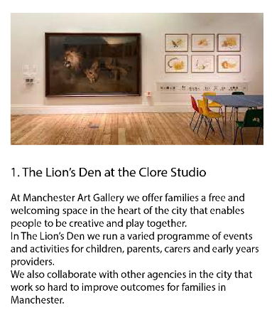
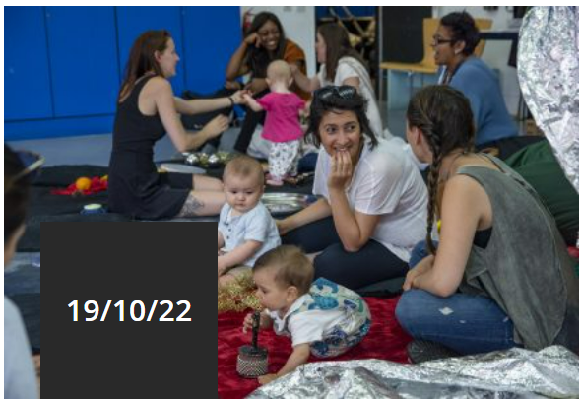
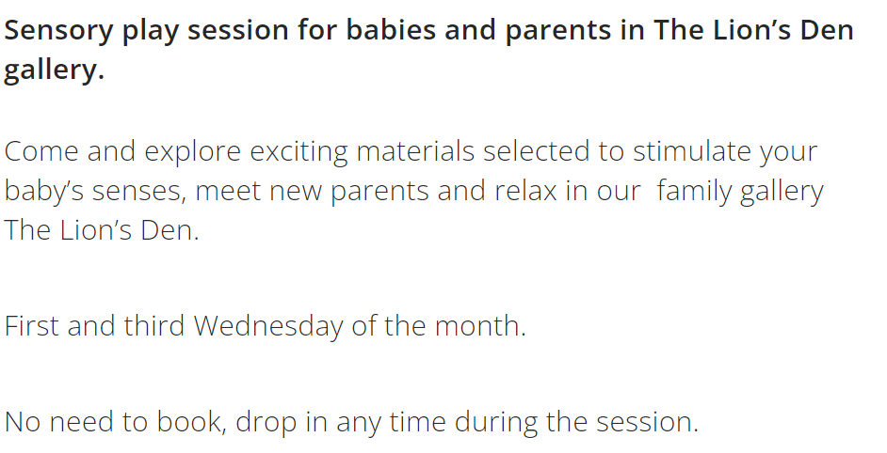
Stay and Play
Baby Sensory (manchesterartgallery.org)
Notes:
Manchester Art Gallery works in partnership with a number of organisations including Martenscroft children’s centre to provide regular drop-in sessions for parents and babies. Like other stay and play sessions (Needham and Jackson 2014) these provide opportunities for parents and children to take a break from what can be quite intense periods together at home and for them to socialise with other families. Such sessions also provide important opportunities to find out about other opportunities and support within the local area (Jackson and Needham 2014).
For the children it is an opportunity to see other babies and toddlers, and to enjoy the wealth of sensory experiences offered in the sessions. The gallery provides a very large and attractive space with large very striking pictures such as the lion shown in the picture. Alongside beautifully presented images produced by children showing to children that their pictures are valued too this is an important part of socialisation (Giddens and Sutton 2018) indicating that children are valued and recognised as part of a community. This develops a sense that children are welcomed and have a right to be included.
Children and parents have an opportunity to see how other families interact with each other and the setting, it is an opportunity to learn how to get along with others and to acquire an awareness of how to behave in a public situation (Jackson and Needham 2014). Parents can learn from other parents and professionals ways to interact with children to give children time to investigate for themselves to share their feelings and responses to objects and to reduce the pressure to focus on naming and counting (Needham and Ulkuer 2020, Carr and Lee 2012).
In a chapter discussing the sensori sessions at the Manchester art gallery (McCall in Hackett et al, 2020 p168) the session leader describes how she has “observed and attuned herself to what kinds of materials babies respond well to and uses these observations when building the environments for the Healthy Child Drop-In and Baby Stay and Play. Lights, sound and bold, graphic, black and white patterns seem to be good for tiny babies whose vision is still developing, but appeals to the older babies too.”

Slide 10
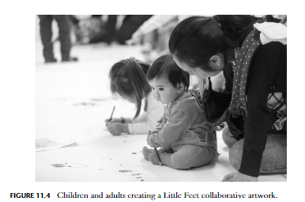
Widening participation
Notes:
Museums can be quite intimidating places that can be perceived as being frequented by older white middle class visitors (Giddens and Sutton 2017). Hoare and Kelland (2020) give examples of how the British Museum has sought to provide family oriented activities timed to coincide with different cultural festivals and to connect with artefacts from particular cultures to promote recognition of pride in cultures. It is very important for galleries to celebrate and showcase a range of cultures if they are to serve the changing populations particularly of the UK’s metropolitan centres.

Slide 11
Hackett et al (2020 p1) present a range of views from those involved in museums and gallery professionals, indicating “there is an increasing interest in how to programme exhibitions, events, activities and practical considerations to best serve this audience. Planning spaces, activities, encounters or visiting experiences for any audience begins with imagination and, coupled with this, are particular ideas and assumptions about the child, the museum and who and what else might come into play when young children visit museums. Reflecting on how well a museum or gallery caters for an audience involves processes of observation and reflection.”
Notes:
Hackett et al (2020 p1) present a range of views from those involved in museums and gallery professionals, indicating “there is an increasing interest in how to programme exhibitions, events, activities and practical considerations to best serve this audience. Planning spaces, activities, encounters or visiting experiences for any audience begins with imagination and, coupled with this, are particular ideas and assumptions about the child, the museum and who and what else might come into play when young children visit museums. Reflecting on how well a museum or gallery caters for an audience involves processes of observation and reflection.” This suggests it is very important for the organisers to observe children and talk to parents about what activities they enjoy.
The gallery is well placed to introduce children to age appropriate objects we can see these reflected in the objects show in the images on both slides. It would be good to see the gallery seeking to include more unusual objects and textiles that extend children experiences beyond the objects available in the home such as the musical instruments shown on the previous slide. It would even more welcome if the gallery were able to include artifacts from a range of time periods and cultures (Hoare and Kelland 2020) as a way to support the inclusion of diverse families since Museums might feel quite foreboding for some parents (Giddens and Sutton 2017) and Manchester’s core collection often represents art produced in the age of Empire.
The gallery is a great space to help children build confidence to enter and feel they belong in other public learning spaces such as this which provide fantastic opportunities for switching children on to learning.

Slide 12
Integrated views of apprehension
Neuroscience is now presenting a view of synapses in young children capturing moments of experiences across all senses registering across the brains neural network eliciting access to similar moments, feelings and responses. Images in older children and adults suggesting that increasing experience tunes us into key features of events and filtering out others in order to help focus attention and activity.
Notes:
Neuroscience which is presenting a view of brain synapses in young children capturing moments of experiences across all senses registering across the brains neural network eliciting access to similar moments, feelings and responses that resonates with these holistic of materials afford to learning (Goswami, 2014) .

Slide 13
How might we use these ideas in practice?
Play
Play with spaces and materials to engage children in physical, emotional, purposeful activity.
Explore
Explore ways that different theoretical perspectives such as ‘affordance’ might further inform our practices.
Learn
Learn to participate in shared thinking and learning stories with children placing more emphasis on ‘emotional’, ‘functional’ , ‘control’ and ‘cultural’ affordances
Consider
Consider how to lend language to explore action, feelings, purpose, control, and shared meanings with children to support their metacognitive view of themselves as learners.
Notes:
Learning that engages body, mind and spirit with the environment should open-up the mind to future learning. These perspectives are seeking to inspire pedagogical practices that should nurture and empower as well as help learners to develop metacognitive self-awareness (Needham and Jackson 2014) .
This is something that is likely to happen naturally in the course of playful interactions at all ages unless we allow indifferent, performative, mechanistic or virtual moments to dominate children’s lived experiences (Livingstone).

Slide 14
Needham and Jackson (2014)
In dual-focused groups in both England and Australia, parents are invited to join in with activities alongside their children. They typically offer two-hour play sessions for groups of 10 or more families and are usually facilitated by an early childhood practitioner or health visitor or both. Such groups often provide play-based activities for children, but they also have an ambition to support parents and influence the home learning environment through nuanced facilitation within a supportive and social environment (Jackson and Needham, 2014).

Slide 15
Notes:
Much of what parent’s do with children might fit into Rogoff’s models of guided participation and shared thinking. See Rogoff, B. (2003) ‘Learning through guided participation in cultural endeavours. In Rogoff, B. (2003) The Cultural Nature of Human Development. Oxford: Oxford University Press.

Slide 16
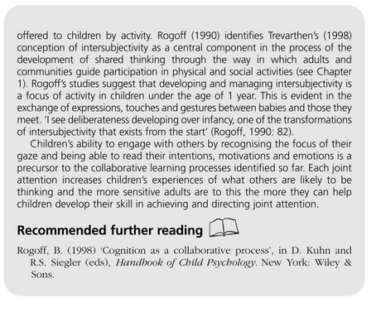

Slide 17
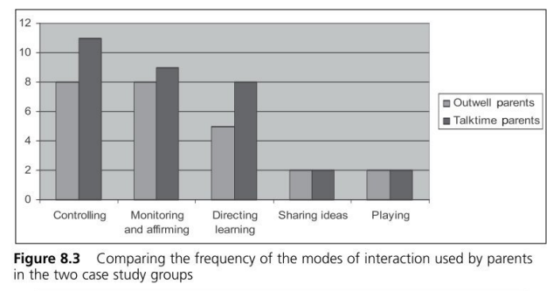
Notes:
What does this table comparing the modes of interaction between parents and their children in stay and play sessions suggest were the most and least common types of interactions between parents and children? How might we want to influence interactions in these groups and how might we do this?

Slide 18
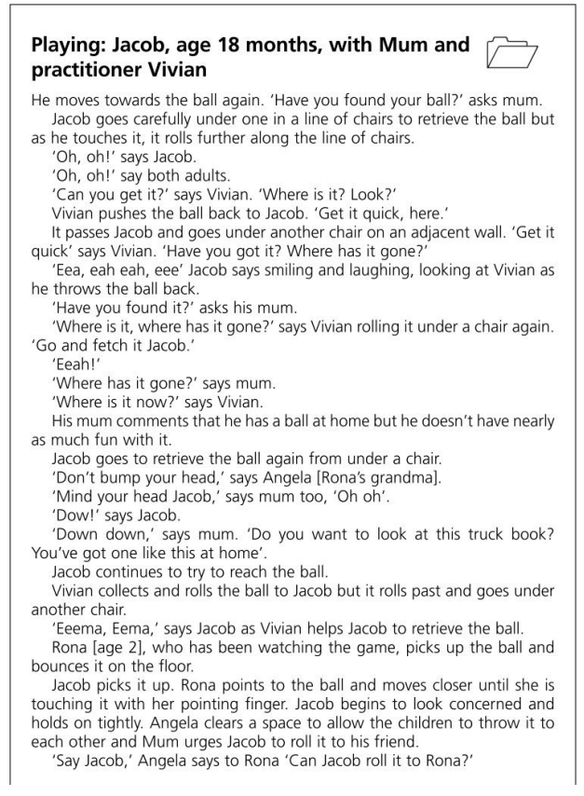
Notes:
Identify the positive features of these two conversations.
Why might you be concerned if the child only experienced on type of interaction?

Slide 19
Spaces to be
We have tried to argue that there is an important role that dual-focused groups have been playing in both England and Australia in developing social spaces where parents, who may have had little in common previously, can come together and form new parental identities alongside supportive peers and practitioners.
Dual focused groups can help some parents to feel more comfortable and confident because the format is less formal. Meaning that they participate rather than opting out.
Relationships with children are delicate and maybe less familiar, things and spaces to see others experimenting with similar issues and share these experiences is a strength of dual focused groups.
Importantly the practitioners in dual focused groups should have additional responsibilities and resources to support those most in need and that such spaces are able to offer support for parenting practices, alongside other forms of support for parents and their children.
Notes:
Whatever a government’s ideology and resources we would argue that there is a need to keep a range of parents’ purpose in mind if we wish to realise the supportive benefits of parent and child groups. Failure to engage with parents’ purposes will continue to distance families from potentially supportive services and serve to undermine many parents’ confidence. We hope that policy makers will continue to recognise the value of dual-focussed groups that support and nurture communities of parents learning from each other, rather than insisting only on more directive courses.

Slide 20
Parents
By arriving at the sessions, the parents gained a feeling of being a ‘good parent’ providing a worthwhile and enjoyable experience for their child. They gained a feeling of being part of a community of good parents grappling with and exploring the challenges of parenthood. Even in taking some time to chat in the sessions parents were enabling the child’s independence but providing a secure point of attachment from which to explore. Providing a space for parents to be implies affording them the space to select, reflect, share and choose how to be.
Notes:
The emotional sensibility of the dual-focussed playgroups studied for the parents
Parents’ purposes suggested that they elected to attend the groups and continued to attend for an extended period because the groups met one or more of the different support needs identified above. Many of the parents’ purposes identified with feeling supported, being respected and accepted as they are because the conversations and activities individualised to them and their child by the group context. The time that the facilitators took to get to know the parent and child as individuals and together contributed to an emotional sensibility that supported the self-image of the parents as being the key person in the child’s life but also left some space for them to be themselves and find their own identity as a parent among other parents. By arriving at the sessions, the parents gained a feeling of being a ‘good parent’ providing a worthwhile and enjoyable experience for their child. They gained a feeling of being part of a community of good parents grappling with and exploring the challenges of parenthood. Even in taking some time to chat in the sessions parents were enabling the child’s independence but providing a secure point of attachment from which to explore. Providing a space for parents to be implies affording them the space to select, reflect, share and choose how to be.

Slide 21
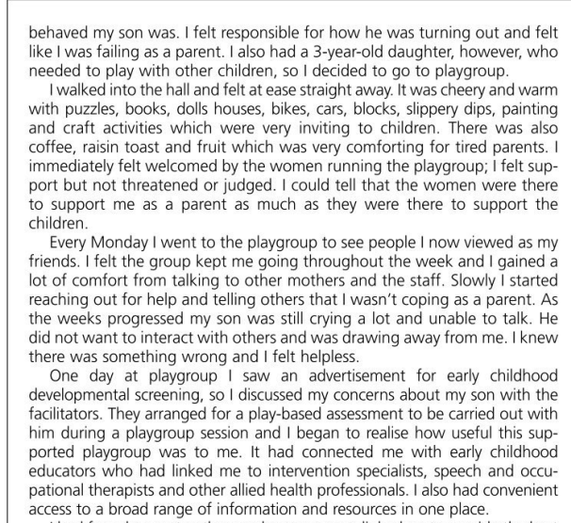
Notes:
Read the interview transcript with a parent, can you match the types of support from the previous slide to this parent’s experiences.

Slide 22
Type of support | Points of view from the dual focused groups
Peer support | I know myself you come in and think it should be like this and gradually you see it works for them and it works for me and it has helped me very much with child rearing and learning to relax.
Learning Support | we were there, to play. The group was about playing with the children and you focus on that… I felt it was a time to learn about playing with your child and for me, here [at home], often there are so many other pressures of work and tidying up
Emotional support | …it [playgroup] might hold mums together... and keeps communities closer-knit, or strengthens the bonds in a community so people can help each other a bit more because they know each other a bit better.
Parenting role support | I think just watching how the things that the workers [facilitators] do with the kids, and watching what they’ re… the interactions that they have with the kids gives you ideas on what you can do at home with the kids.
Information and resource support | I remember there was one time, B threw a tantrum and one of the staff came because I was struggling to know what to do...and she said something or suggested a book I could read... And it just made me realise that there was a different way of handling that situation than the one I was using. Which was obviously not working anyway.
Friendship and social network | Time for me to have a chat, it’s nice to know that there are plenty of activities for them[children] to do so you can just relax and have a chat and I’ve been coming here for three years now so in itself it’s a support so you can share problems and share ideas
Notes:
Parents’ views and sense about why they attended dual-focused groups and what they perceived they gained from the groups shared several features across both countries and different groups. The findings also illustrate some of the more subtle emphasises offered by different parents. In the examples of parents’ purposes presented here, we seek to reflect on the range of benefits to both parents and children in order to return to consider how these might be supported or discouraged by the policy initiatives discussed in the literature review.
Benefits for Children
Social support
The key motivation offered by many parents for attending parent and child groups was to provide opportunities for their children to become accustomed to being in social environments alongside other children. This is highlighted in the first example below, where the purpose is nestled alongside other child-focused purposes about spending quality time together. It is also evident in several of the subsequent examples.
It is good for him to mix with other children, he does go to nursery, but it is good to be here doing things with me and his brother and sister as well and doing activities together. And when they are all a little bit older because they are only 5 or 6 months at the moment but it will be good for them to mix with me being there as well. I think my role, well because they are so little, just looking after them all. But it is nice for me to come and do something with Evan together. I would hope that we could play together and do things although sometimes he doesn’t and sometimes I’m too busy but it is a chance for us to be out of the house together with other people around instead of us three in the house. (Parent)
Learning support
Parents identified play as a very important aspect of attendance at the groups. They were appreciative of the alternative and extended range of learning materials and experiences that were available in all the groups studied. Children’s play was seen as fundamental and the facilitators in these cases were successful in creating welcoming play environments that were rich in child-driven and adult-directed experiences. Activities and play spaces were provided that engaged the broad range of children who attended the groups, and offered them play opportunities in which they could participate independently, with their peers or with their parents and other adults.
Yes, that’s why we were there, to play. The group was about playing with the children and you focus on that… I felt it was a time to learn about playing with your child and for me, here [at home], often there are so many other pressures of work and tidying up that playing with T here [at home] wasn’t like quality time to play. Going to playgroup felt like an opportunity to quality play. (Parent)
Benefits for Parents
Friendship and social network support
In both studies the creation of social spaces for parents that emphasised positive relationships and provided opportunities for social interaction enabled the development of significant friendships and social networks. This assisted in the reduction of social isolation and contributed to parents’ sense of wellbeing, confidence and ability to support one another.
Time for me to have a chat, it’s nice to know that there are plenty of activities for them[children] to do so you can just relax and have a chat and I’ve been coming here for three years now so in itself it’s a support so you can share problems and share ideas. (Parent)
The ability for these groups to support positive interactions with and between all families was integral to what parents experienced as supportive and this was true regardless of whether families were perceived to be vulnerable or well functioning as is often the case in targeted, government-funded programs.
Relational support
Some of the parents found establishing relationships with other adults challenging. Enhancing social connectedness among parents in groups sometimes required facilitators to manage difficult group dynamics. Mediation processes were used to address challenging issues or behaviours when they arose and this furthered the positive development of relationships within groups. Importantly, these processes enabled parents’ continued participation in the groups, which resulted in their continuing access to support but it also helped some parents to identify strategies for negotiating relationships in other contexts.
There’s always the risk that people will come [to the group] and actually be harmed because the interactions are negative towards them, and they actually go away feeling less well off than when they came. So because of that risk, I think it’s quite important to keep an eye on the overall dynamic, and make sure that that stays positive... more consciously demonstrating strength- based parenting... Because... if you feel judged as well, it doesn’t really help you change. It just makes you feel more probably bad about yourself...
(Facilitator )
Peer support
Peer support emerged as an important element these groups. There were numerous examples of how parents used their interactions with other parents to increase their knowledge and parenting skills and as a means to view their children’s behaviour from varying perspectives. Many parents described their increased sense of confidence in parenting as a result of observing their children in relation to others at similar stages of development and in interactions with adults other than themselves.
R: So do you have any new knowledge or insights as a result of attending the playgroup?
X: My understanding of myself as a parent and of other people’s
skills as parents.
Y: You do pick up things, like if your child is going through something you can talk to other parents and get more of an idea of what to do.
P: Yes, and you can see that everybody has different styles of
parenting. It’s OK.
X: I know myself you come in and think it should be like this and gradually you see it works for them and it works for me and it has helped me very much with child rearing and learning to relax. (Focus group parents)
Emotional support
Emotional support was integral to the relationships developed by group facilitators with parents, particularly in cases where parents were known not to have experienced nurturing relationships themselves. Parents benefited greatly from facilitators expressing genuine care and respect for them and appreciated being listened to. It was important to them to develop relationships with facilitators that were based on mutual respect, understanding and care and this type of support enhanced their ability to provide nurturing care to their children.
The friendships that they make, I think, is the most important aspect...when you look at all of that happen, and I think as workers, if we can set that up and set the forum up for them to meet in a safe space and be there if they need us, is fantastic, because they can do the rest... (Facilitator)
To add to this, many parents reported that they now participated in broader community activities and had increased their social networks and become more linked to their local school or community as a result of their playgroup attendance.
…it [playgroup] might hold mums together... and keeps communities closer-knit, or strengthens the bonds in a community so people can help each other a bit more because they know each other a bit better. It’s probably not something you can really quantify… I walk around the community and I’m like, hello, hello and I know lots and lots of people and I can see him [partner] going, you seem to know everyone around here. And how valuable is that? How do you quantify or put a value on that, the fact that you can walk around in your own community and know people? (Parent)
Parenting role support
Creating non-judgmental spaces in which parents were unconditionally accepted and respected affirmed their roles as the most important people in their children’s lives. In turn, this promoted safe environments in which positive behaviours were modelled and gentle guidance in relation to child development and parental expectations was provided. Under these circumstances parents gained new insights that were reflected in positive changes in their relationships with their children.
I think just watching how the things that the workers [facilitators] do with the kids, and watching what they’ re… the interactions that they have with the kids gives you ideas on what you can do at home with the kids. Whereas normally you just go, Oh go away, I’ve had enough of you. Go away. (Young parent)
Information and resource support
The playgroup facilitators’ broad knowledge of local service systems, combined with their knowledge of child development and learning, enabled them to assist parents with timely and practical support in addressing pressing needs. Providing access to information and resources at a time and place that was appropriate and relevant was extremely important to parents in this context and reflected the soft entry nature of the service provision.
I remember there was one time, B threw a tantrum and one of the staff came because I was struggling to know what to do...and she said something or suggested a book I could read... And it just made me realise that there was a different way of handling that situation than the one I was using. Which was obviously not working anyway. (Parent)
‘Circle of care’ support
It was extremely beneficial to have the needs of more vulnerable families in the playgroups met by a broader network of health, education and social welfare professionals who work in partnership with the facilitators. By creating a ‘circle of care’, facilitators were able to draw on relevant resources that enabled a holistic approach within the groups. This enabled the provision of emotional and practical support that enhanced families’ ongoing participation.
I think the environment we create of informal support around the professional experts who are coming, that just makes all that so accessible, because it is a single point of contact, which is a preferred way of receiving services for a young person. (Facilitator)
Multidisciplinary support
Providing multidisciplinary support assisted parents to access, within the playgroup context, a range of formal services that they may not have been able to access otherwise. The playgroups created non-clinical, non-stigmatising environments in which other professionals (such as early childhood intervention teachers, social workers or speech therapists) could work with parents and children. Families’ access to other types of support was increased substantially by embedding services in this way.
...what we were able to bring to the parents by having that amazing resource of skilled workers who were all there, with the aim to benefit young parents’ lives and their children’s lives, was a fantastic strength… (Facilitator)

Slide 23
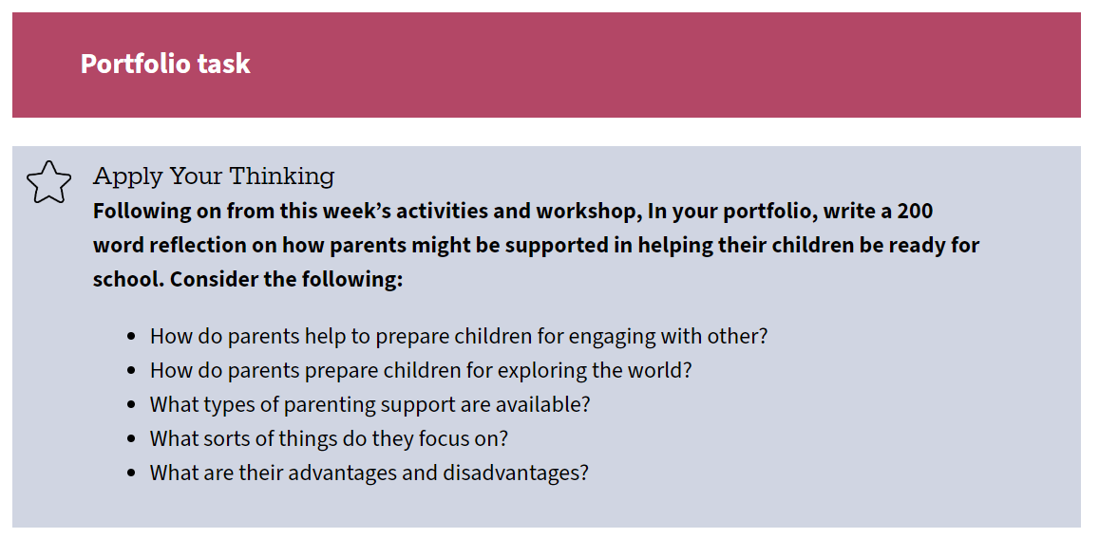
Learning and Assessment
Firm Foundations Assessment
Students studying this short course will produce a regularly updated, templated and annotated synthesis portfolio/workbook. This will capture their new learning as an ongoing reflective journal. Word count: 3000 (or equivalent).
ActiRise at Manchester Met (mmu.ac.uk)vity 1.

Slide 24
References
Anning, A. (2014) Is working together working? in Maynard, T., & Powell, S. (2014). An introduction to early childhood studies (Third ed.). Los Angeles: SAGE.
Cameron, D. (2016) Prime Minister's speech on life chances [speech transcript] retrieved from
https://www.gov.uk/government/speeches/prime-ministers-speech-on-life-chances
Colliver, Y. (2016). Mothers' perspectives on learning through play. Australasian Journal of Early Childhood, 41(1)
Cullen, S.M., Cullen, M. & Lindsay, G. (2016) "Universal Parenting Programme Provision in England; Barriers to Parent Engagement in the CANparent Trial, 2012–2014", Children & Society, vol. 30, no. 1, pp. 71-81
Goswami, U. C. (ed.) (2014) The wiley-blackwell handbook of childhood cognitive development. Second edn. Malden, Mass.: Wiley-Blackwell (Blackwell handbooks of developmental psychology).
Hackett, A., Holmes, R. and MacRae, C. (eds) (2020) Working with young children in museums : weaving theory and practice. London: Routledge/Taylor & Francis Group (Global Perspectives on Children in Museums)
Jackson, D. and Needham, M. (2014) Engaging with parents in early years settings. First edn. Los Angeles: SAGE.
Parenting Research Centre, (2016) The Early Home Learning Study [webpage] retrieved from http://www.smalltalk.net.au/about-smalltalk/research-ehls/
Rogoff, B. (2003) ‘Learning through guided participation in cultural endeavours. In Rogoff, B. (2003) The Cultural Nature of Human Development. Oxford: Oxford University Press.

