Slide 1
Firm Foundations School Readiness
Dr Martin Needham
M.Needham@mmu.ac.uk

Slide 2
Overview of School Readiness sessions
Rise at Manchester Met (mmu.ac.uk)
Activity 1.
Week 1 What is school readiness? Preparation for school by being controlled, independent, communicative or Starting school early and Schools being ready to be inclusive destinations.
Week 2 Parents and Children together -Supporting Authoritative Parenting - example Martenscroft Stay and Play
Week 3 Play and Child led learning- What is play and why is it so good for children? Example Evaluation of play resources at Martenscroft
Week 4 Plan Do Review- Drawing attention to learning- encouraging children to set targets and evaluate them developing time management. Example Highscope Approach, USA
Week 5 Creativity- exploring materials, solving problems, developing storylines, Slow Learning –Time Example Regio Emilia Italy
Week 6 Assessment and dispositions Celebrating what children can do and sharing learning stories with children and parents. Example Te Wharikki New Zealand

Slide 3
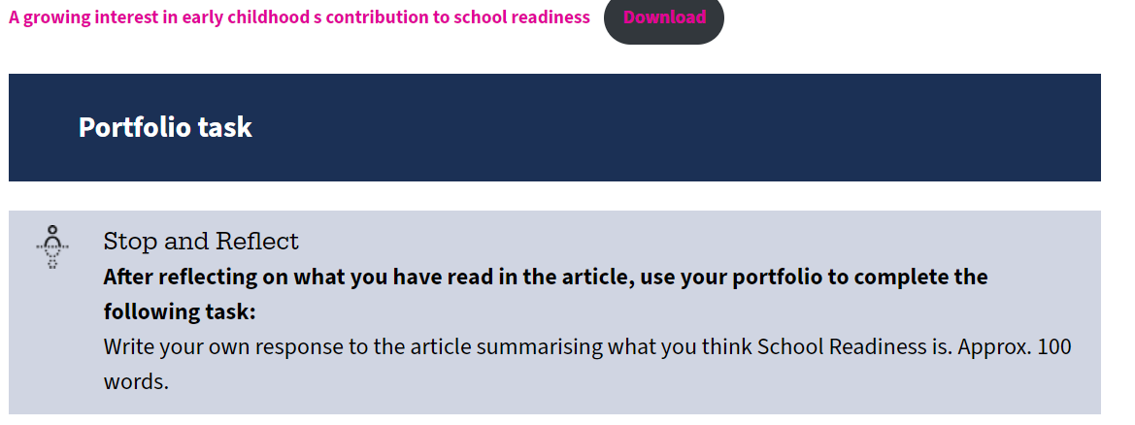
Learning and Assessment
Firm Foundations Assessment
Students studying this short course will produce a regularly updated, templated and annotated synthesis portfolio/workbook. This will capture their new learning as an ongoing reflective journal. Word count: 3000 (or equivalent).
Activity 1.
Rise at Manchester Met (mmu.ac.uk)

Slide 4
Outline of today’s workshop
Our Purposes of today
To introduce the unit structure and assessment
To be able to identify the two different sometimes complimentary sometimes competing interpretations of school readiness
To examine and evaluate the evidence and arguments from both perspectives.
To apply these perspectives to preschool activities and case study children
Activity 1.
Activity Week 1 Two contrasting getting to know you activities
Thinking about process, content and skills.
Activity 2. Introduction to the unit
Discussion of the examples of school readiness
Activity 3.Discussion of the case study Children
Activity 4. Close reading of Needham & Ulkuer Article
Activity 5. Debating for and against each perspective.

Slide 5
Form, size, quantity
Activity One.
In pairs, one partner will be provided with some play dough and asked to produce a sculpture of an object to represent school they should talk about their object, together with how and why they are making it, while they create it.
The other partner must keep their eyes closed all the time while this is going on. They will also be provided with some dough and asked to recreate the same sculpture without looking. Only listening.
The person making the first object can help their partner by providing instructions to help their partner re-create that sculpture.

Slide 6
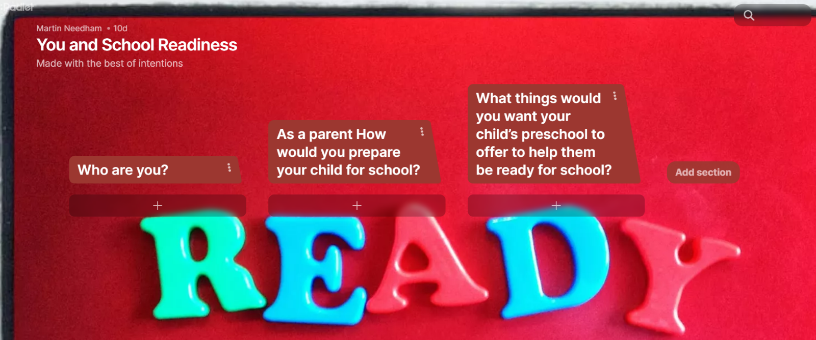
What about us?
Visit the Padlet You and School Readiness (padlet.com) leave your responses to the tasks set there.

Slide 7
Process, content and skills
Both of our introductory activities feature different processes, knowledge and skills.
In pairs compare the two activities thinking about what you gain from each.

Slide 8
Practicing for school | Being ready for school
These activities echo the sorts of activities that the children will experience in school and allow children to practice the skills that feature in school. I.E. Practicing writing a letter and colouring object on a worksheet that begin with that letter | These activities may be undertaken independently and are intended to support general development they are intended to build children’s confidence in themselves and ability to relate to others
type activities here | type activities here

Slide 9
How will the different types of activities help and hinder Happiness and Oscar?
Case Study 1
Happiness is 5 years old and has recently moved to the Moss Side from Nigeria with her mother who is studying in the UK for a year. She has been attending a Fee-paying Montessori Kindergarten in Nigeria for the last 6 months. She is lively and outgoing and has made friends in the kindergarten, engaging enthusiastically with the play-based activities group stories and songs. She can write her own initials and knows some letter names and can count up to 20 without prompts. She has been going to the toilet by herself since she was two and a half.
Case Study 2
Oscar is 4 and a half years old, and his Family have been living in Hulme for some time. Oscar was born prematurely and has been susceptible to respiratory infections since he was small and has Asthma. He has spent most of his time at home with his parents who are able to take turns caring for him through shift work. Oscar has attended some preschool sessions since he was 2 but this has been a little irregular mixed with periods of illness. He is sometimes upset and reluctant for his parents to leave and then is quite clingy to staff members preferring to be close to them and observe them rather than join in with play. He is quite quiet but asks for the things he needs. Oscar likes story and rhyme times when everyone sits together. Oscar was still in Nappies when he started preschool and has recently started using the toilet independently following an initiative from the preschool working with Oscar’ parents.

Slide 10
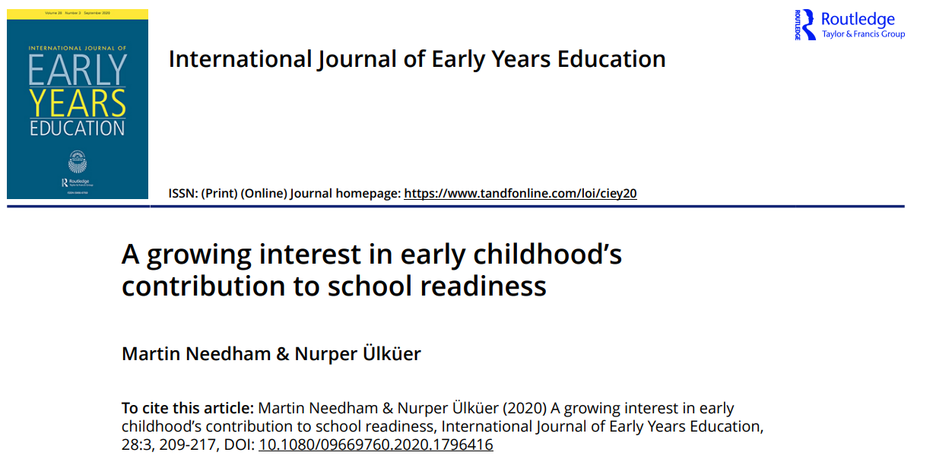
Needham and Ulkuer (20

Slide 11
Where does the term school readiness come from? ( Needham and Ülküer 2020 p209)
James Coleman’s report on equality and education published in the mid-1960s (Coleman 1966) made a blunt statement that children, especially the ‘non-white children’ in the USA were not enjoying equal opportunities in education, as they were not coming to school ‘ready’. Reading the report now, the race and class bias in system is very apparent; it sought to compensate for the perceived social-cultural-economic characteristics of the home and family environment that was emphasised as playing a decisive role in children’s school achievement. The report concluded that in order for children to succeed in school, they needed to be prepared through preschool programmes, such as Head Start.

Slide 12
Evidence of successful programmes (p209)
The Coleman report concluded that in order for children to succeed in school, they needed to be prepared through preschool programmes, such as Head Start. The longitudinal success of Head Start in the USA reported by Weikart in the 1990s presented findings about the long-term situation….. It showed improved school outcomes, improved career prospects, reduced social and health interventions in later life.
SureStart initiated in the UK in the late 1990s was an example of such political and pedagogical response towards achieving equality of education through early childhood education (Needham and Anning 2017).
The longitudinal research legacy of both of these programmes emphasised the importance of the home learning environment together with access to a preschool pedagogy that balances both adult-lead and child-lead, play-based learning (Schweinhart 2013; Sylva et al. 2010)

Slide 13
Concerns about school readiness becoming standardised and assessed(p210)
Moss and Urban (2020) continue to report with concern the development of the International Early Learning and Child Well-being (IELS) as a standardised assessment for children at age 5. By paying considerable attention to literacy, numeracy and self-regulation they are concerned that it will add to existing pressures to standardise young children’s preschools who will be currently be experiencing very different learning contexts

Slide 14
A broader view of school readiness (p210)
School readiness can be used as a platform to highlight support for children’s social, emotional, language, and a wide range of communication skills, particularly to promote equity for children in ‘disadvantaged’ circumstances. This creates a much broader educational base for school subjects to build upon subsequently. Many argue that early education should remain a distinctive pre-primary phase matched to younger children’s interests and abilities rather the school curricular.

Slide 15
Early Interactions are important (p211)
Shonkoff and Phillips (2000) have emphasised the importance of the first three years of life offering a window of opportunities that shape the brain architecture, not only in terms of developing cognitive and language skills but also social-emotional skills. Shonkoff and Phillips (2000) suggest children’s brain architecture is shaped by ‘adult-child’ interactions through play and communication in a style referred to as ‘serve and return’ as in a table-tennis match. Such studies have widened the focus ECE interventions to include even earlier ages, starting with a strong emphasis on stimulation and play from birth. This approach, however, emphasises need for strong child-parent interactions (primary caregiver) to build social-emotional ties that form the foundation for child’s development including cognitive and language skills.

Slide 16
Play-based, child-centred and active learning techniques(p212)
Pre-primary classrooms are not simply a downward extension of primary classrooms and schools – they are very different in terms of purpose, organization and function. Pre-primary education usually employs play-based, child-centred and active learning techniques to create a nurturing learning environment. Good pre-primary programmes foster and facilitate children’s holistic learning, including key social and emotional skills such as sharing, collaborating and managing feelings. This contrasts with what is often a more structured academic approach at the primary level. (UNICEF 2019, 86)

Slide 18
References
Needham, M & Ülküer, N (2020) A growing interest in early childhood’s contribution to school readiness, International Journal of Early Years Education, 28:3, 209-217, DOI: 10.1080/09669760.2020.1796416

