Slide 1
Welcome to the Rise Compassionate Care Short Course Briony Spedding b.spedding@mmu.ac.uk
Notes:
Mark Peace

Slide 2
Week 4 Workshop
Professional roles and relationships
David Evans
& Briony Spedding

Slide 3
Compassionate Care In Practice
The session today
Understand the complexity of communication and steps to help.
Explore examples of undertaking difficult conversations.
Consider communication in the context of professional roles and relationships
Making sense of making sense: what is communication
Experience of communication: communication in the real world
Discussion 1
Thinking about a difficult conversation and what mattered to me?
Discussion 2
Looking at a NHS case study of failings in communication and consider what mattered to them?

Slide 4
What matters to me?

Slide 5
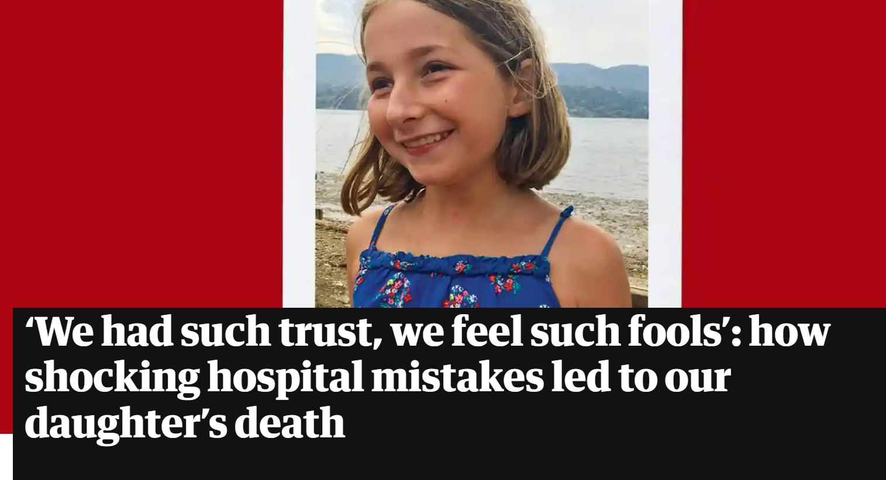
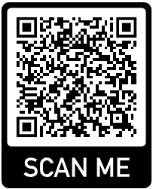
https://www.theguardian.com/lifeandstyle/2022/sep/03/13-year-old-daughter-dead-in-five-weeks-hospital-mistakes

Slide 6
Compassionate Care In Practice
Assignment Guidance
Learning Outcomes for the Unit
By the end of this unit you will be able to…..
Respond in practical ways to the holistic needs of people who are supported by health and social care services, considering their social, emotional and physical wellbeing.
Identify how care and support can be tensioned and problematic and lead to unintended consequences.
Reconstruct care plans to incorporate a more nuanced and responsive recognition of the complexities of support.

Slide 7
Unit Assessment
Create a fictional pen-portrait of a person supported by health and/or social care services.
Use the pen portrait to demonstrate the complexities and dynamics surrounding ‘care’ and ‘support’.
You can be creative with your assessment, for example, you could submit your assessment as a word document or a powerpoint presentation.
You can include images in your submission.

Slide 8
Unit Assessment
You can be creative with your submission and submit in a variety of formats, for example
A written assignment in the form of a word document
A PowerPoint presentation (with or without recorded commentary)
A digital video recording of yourself presenting
A submission in the form of a blog
Unit assessment deadline: Tuesday 27th June 2023
Submission is via Moodle – here is a link to the submission area though it may not show as available until closer to the submission date
1CWK100 - 1 Coursework 100% (494Z0011_2223_S) (mmu.ac.uk)

Slide 9
Unit Assessment
Outline the unique characteristics of the person and describe the needs which mean they access support from health and/or social care services.
Think about what care and support services might be available to support them.
What would good care and support look like for this person?
How can services ensure they have considered the social, emotional and physical wellbeing of the person?
What might some of the challenges be for professionals who might be working with this person?
Think about what might need to be taken into account to ensure the care and support provided to this person takes into account their unique needs alongside their background and expressed wishes.

Slide 10
Unit Assessment
Use the work you have completed each week to support you with the assignment.
If you are basing your pen portrait on real examples your work or personal experience please be sure to anonymise identifiable details about the person, location or service.
The following slides are an example of a suggested format, please don’t feel you have to follow this format, you can be creative with your format and consider a word document, a PowerPoint, a video submission or a blog

Slide 11
Compassionate Care
Nya (She/Her)
Introduce Nya: who is she? What is important to her?
What are Nya’s health and/or social care needs?
Why does she access or have contact with health and social care services?
How does she feel about having contact with services?
What has her experience of contact with services been life?

Slide 12
Compassionate Care
Nya (She/Her)
Who has been involved in supporting Nya?
How did the support come about? Who might be involved? Is there more than one service involved?
Are there any pertinent issues about how services engage with Nya? If so what are these?

Slide 13
Compassionate Care
Nya (She/Her)
How have decisions been made about the support Nya receives?
Who had the loudest voice?
What have some of the challenges been? Have there been barriers, dilemma’s or risks that have had to be addressed?
How was this manged? What needed to happen?

Slide 14
Compassionate Care
Nya (She/Her)
How can people who work in a service make sure they are working in a person centred way?
What skills and knowledge to individual workers needs? How can they be supported to develop and achieve these?
What are some of the challenges for organisation to provide good care and support? What needs to change to achieve good care and support for people?

