Slide 1
Health Inequality & Mental Illness
Stephen Marks

Slide 2
This session will cover
How we define health using different models and theories.
What are health inequalities.
Mental Health vs Mental Illness
The wider determinants of health & Group Activity

Slide 3
What is Health?
‘A state of complete physical, mental and social well-being and not merely the absence of disease and infirmity’.
(WHO 2020)

Slide 4
Other perspectives..
In 1986, the Ottawa Charter for Health Promotion acknowledged that ‘health is created and lived by people within the settings of their everyday life; where they learn, work, play, and love.
What do you need to feel healthy?
Can we actually define health for all?
Svalastog et al (2017) stated that this gradual development of the concept of health introduced an appreciation that health is determined by the everyday settings in which people live.

Slide 5
Medical model v Positive model
Medical model:
Health is viewed in terms of an absence of illness, disease or disability. This is a narrow perspective focused primarily on people’s physiology, the mechanics of illness and how to ‘fix’ the body when people are unwell or sustain injury.

Slide 6
Medical model v positive model
Positive model:
Positive approaches to defining health consider health as an asset and refer to it in terms such as well-being.
When health is viewed positively, definitions tend to be broader and include concepts such as happiness.
The WHO (2020a) definition is one example of a positive approach to health and the move away from a medical and primarily negative view of health.
What are the pros and cons of this approach?

Slide 7
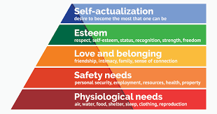
Maslow’s hierarchy of need- a theory of human motivation (1943)

Slide 8
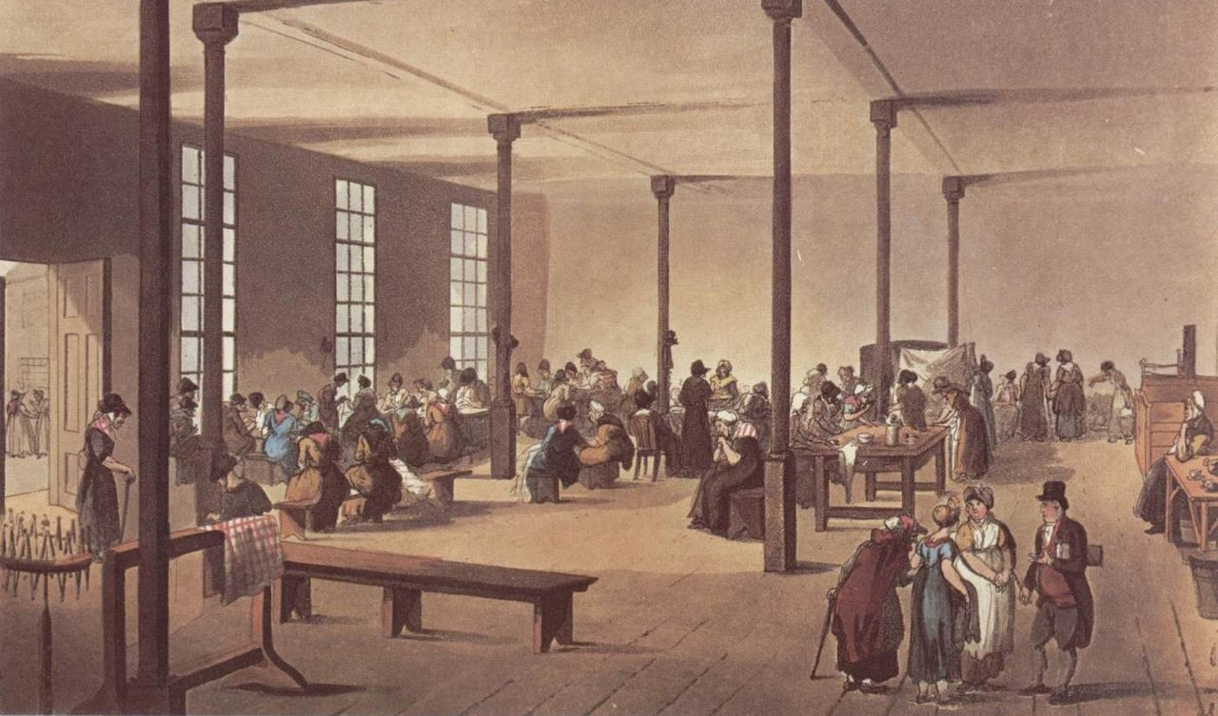
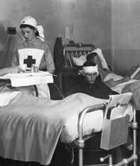
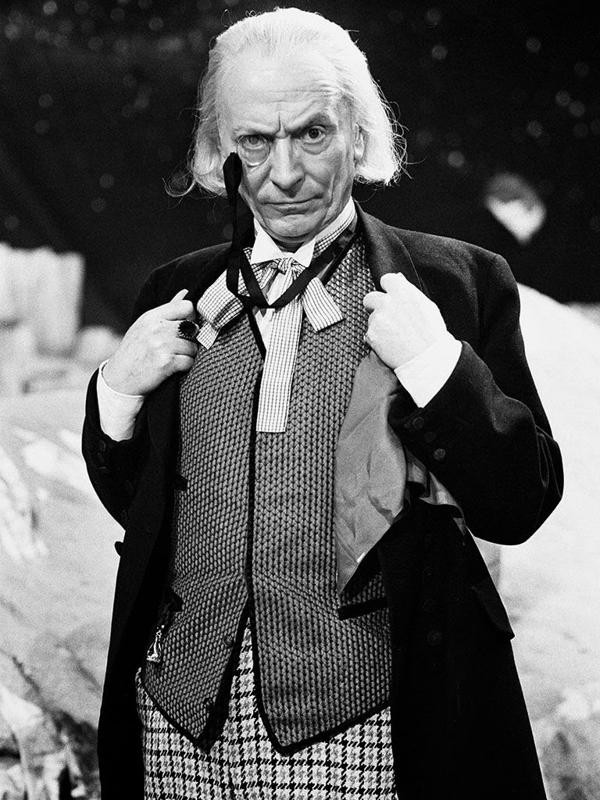
Health Inequalities
This Photo by Unknown Author is licensed under CC BY-SA
As far back as 1840, Edwin Chadwick demonstrated mortality differentials between the social classes living in Liverpool. Chadwick thought that these differences were likely due to poverty and lifestyle factors common to the poorer ‘working classes’
This Photo by Unknown Author is licensed under CC BY
This Photo by Unknown Author is licensed under CC BY-SA-NC
This Photo by Unknown Author is licensed under CC BY

Slide 9
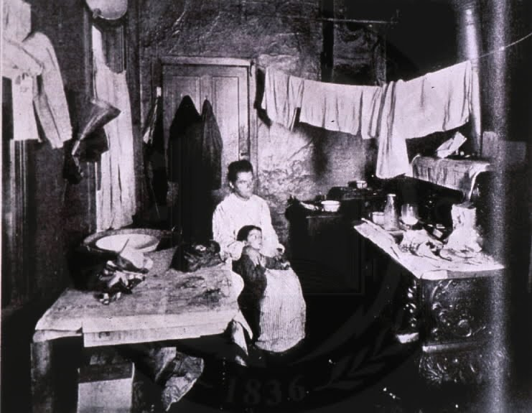
The strongest influences on health are the circumstances in which we are born, grow, live, work and age. (The Health Foundation, 2019) Foundation 2019)
This Photo by Unknown Author is licensed under CC BY-NC-ND

Slide 10
The history of health inequalities
19th century The ‘Poor Law’ – Local responsibility to provide help for those in need, usually through workhouses.
Early 20th Century – Voluntary hospitals provided access to health care for the poor not in workhouses. These hospitals were funded by donations and run by volunteer staff (1/3 of beds in England were this type of hospital).
Florence Nightingale worked in a voluntary hospital.
National insurance – introduced in 1911 this provided workers with some level of protection against the risk of falling ill and being unable to work. Those contributing to the scheme were eligible to see approved doctors and for some treatment such as for TB. This covered around 40% of the population.

Slide 11
Beveridge Report (1942)
Following WWII increased public desire for social welfare services and the ‘welfare state’ was born, funded by compulsory contributions from citizens. It cited the 5 wants that the welfare state could tackle:
Want
Disease
Squalor
Ignorance
Idleness

Slide 12
The National Health Service- 5th of July, 1948
The NHS Act, brought before parliament in 1946, was created as part of a social welfare policy under Clement Atlee’s Labour government which aimed to provide universal and free benefits to all those in need.
The National Health Service was launched on 5 July 1948 by the then minister of health, Aneurin Bevan, and was to provide healthcare that was free at the point of delivery.
The principles of the NHS were to provide a comprehensive service funded by taxation, available to all and free at the time of need.

Slide 13
The Black Report (1980)
The group found that there were differences in mortality rates across the social groups, with those in lower social groups suffering higher rates of mortality.
The report also found inequalities in access to health services, particularly preventative services, with low rates of uptake by the working classes.
It agreed that early childhood was the period during which the link between class and ill health could be most effectively tackled.
Much of the cause of widening health inequalities was attributed to income inequalities, work or unemployment, environmental factors, access to education, and differences in lifestyle.

Slide 14
The Black Report recommendations
The group's recommendations focused on increased government intervention and spending in community health and primary care, but also on broader social policy such as:
increasing child benefit
improving housing
agreeing minimum working conditions with unions.

Slide 15
The Black Report
By the time of publication, there had been a change in government and the Conservatives did not accept or endorse the recommendations due to the proposed scale of expenditure.
“It is, I think, one of the tragedies in which many of the benefits we give, which were meant to reassure people that if they were sick or ill there was a safety net and there was help, that many of the benefits which were meant to help people who were unfortunate … that was the objective, but somehow there are some people who have been manipulating the system … when people come and say: ‘But what is the point of working? I can get as much on the dole!’ “ (Thatcher, 1987)

Slide 16
Sir Michael Marmot
Fair Society Healthy Lives – Feb 2010 (Labour Government)
This concluded that reducing health inequalities would require action on six policy objectives:
Give every child the best start in life
Enable all children, young people and adults to maximise their capabilities and have control over their lives
Create fair employment and good work for all
Ensure healthy standard of living for all
Create and develop healthy and sustainable places and communities
Strengthen the role and impact of ill-health prevention.
This Photo by Unknown Author is licensed under CC BY-SA-NC

Slide 17
The government response…
The government had originally set up Public Health England to manage the implementation of public health including health inequalities.
New departments set up following covid and the evidence that it was not fit for purpose:
Office for health improvement and disparities (OHID)
UK health security agency (UKHSA)

Slide 18
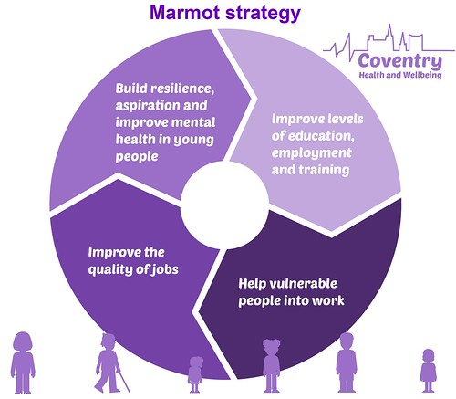
Marmot cities and communities
This Photo by Unkwn Author is licensed under CC BY-NC-ND

Slide 19
How do social determinants impact on health?
Social Determinants of Health Animation – YouTube
Environments in which we are born, grow, live, work and age impact on how healthy we are.
Social and economic factors impact health (housing, healthy food, green spaces, transport, education, employment, ability to make choices).
Stressful circumstances over a long period of time can lead to poor health.
Diabetes, CV disease, depression, anxiety and mental illness.
In the health sector we can change things.

Slide 20
Dahlgren and Whitehead (1991 / 2021)

Slide 21
Mental Health v Mental Illness
With a partner discuss the differences between Mental Health & Mental Illness
Consider some of the previous definitions
Consider mental health awareness campaigns?
What divides mental wellness from mental illness?
2-3 minutes then feedback
Notes:
The discourse around mental health is improving, HOWEVER, I still think the mainstream discourse is quite sanitised and it still doesn’t really include the most vulnerable and most unwell.
While initiatives like MH Awareness Week are important, they focus on (what I think) are quite superficial issues. For example, on the current page for MH Awareness Week 2022 the main thing is lonlieness. Obviously a very important thing to tackle, but it’s not a psychiatric disorder. Likewise, look at this fundraiser idea

Slide 22
References
Health Equity in England: The Marmot Review 10 Years On - The Health Foundation
Fair Society Healthy Lives full report (parliament.uk)
What is happening to life expectancy in England? | The King's Fund (kingsfund.org.uk)
The Dahlgren-Whitehead model of health determinants: 30 years on and still chasing rainbows – ScienceDirect
Dahlgren G, Whitehead M. 1991. Policies and Strategies to Promote Social Equity in Health. Stockholm, Sweden: Institute for Futures Studies.

Slide 23
MH Awareness Week 2022
Notes:
When you’ve worked in secondary MH for as long as I have you realise that many of our patients simply do not have access to these things
They are the most marginalised, socially excluded people in society. For many of them, friendships are hard to come by, never mind book clubs or jobs.
It’s all a very sanitised, middle class orientated scheme.
There’s not a single mention of depression, anxiety, schizophrenia etc.
I don’t have a problem with these initiatives, but I just think there’s such a mismatch between MH and Psychiatric Disorder
My partner’s employer put on a MH day at work which involved eating overnight oats.
And maybe I am sensitive to this because of the comments I’ve had about my role and career over the years
Even as an AP I would get comments from nurses on medical wards saying ‘oh you guys just have cups of tea and chat’ – right after I’ve come along analysed some blood results, prescribed medication etc.
Hopefully this session will dispel some myths about mental illness and the profession.

Slide 24
Facts and Figures
Data from How common are mental health problems? - Mind

Slide 25
Facts and Figures

Slide 26
Serious Mental Illness / SMI

Slide 27
SMI
People with SMI die 15-20 years earlier than general population
More likely to be isolated
Co-morbidity
Suicide
Multiple negative associations with Rainbow model

Slide 28
Notes:
SMI much less common than the 1 in 4 stat, but has a significant lifelong burden for the individual and healthcare services.

Slide 29
Group Exercise
In small groups use the flip chart paper to consider some of the differences in health between people living in deprived areas and people living in affluent areas.
List some of the factors which might influence health inequality
Use the headings on the rainbow model to help structure your thoughts. E.g. housing, unemployment, working conditions, health care services, individual factors, lifestyle factors, education, access to quality food
Also consider how a serious mental illness would impact on this. Would someone with an SMI have the same work / education opportunities? What would the knock on impact of this be?

Slide 30
Physical Health Inequality

Slide 31
Summary
Many theories on health, but most agree that health is more than just the absence of disease.
Health is significantly impacted by factors largely outside of the control of the individual.
Lifestyle factors and genetics are important, but we need to focus on the wider societal picture.
Mental illness is distinct from day to day discourse on MH / MH awareness

Slide 32
Physical Health Inequality
Severe mental illness (SMI) and physical health inequalities: briefing - GOV.UK (www.gov.uk)
What are health inequalities? | The King's Fund (kingsfund.org.uk)

Slide 33
Physical Health Inequality
(252) Reducing inequalities in mental illness – YouTube
Additional Reports
Severe mental illness (SMI) and physical health inequalities: briefing - GOV.UK (www.gov.uk)
What are health inequalities? | The King's Fund (kingsfund.org.uk)

