Slide 1
Stigma and shame

Slide 2
Thinking about the prep work?
What do we think about stigma and shame?
What are the key points?
What has challenged our own assumptions?

Slide 3
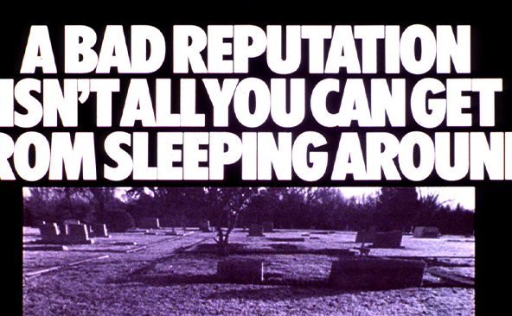
Fearmongering
How do these images create fear?
How do they relate to shame and stigma?
How does this impact care or enable people to care for themselves?

Slide 4
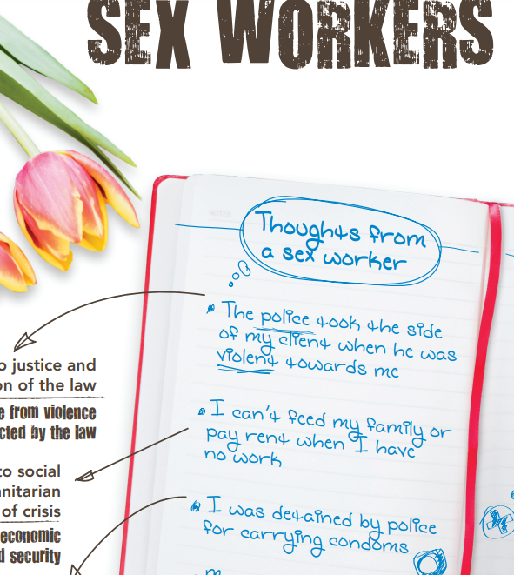
How does stigma impact on the care sex workers may face?
What types of attitudes might they encounter?
Use the sheet to help you think about this

Slide 5
Lego activity
Use the lego to design a service – charity, health, social acre etc that works for sex workers and people living with HIV.
Use the Lego to address the barriers you think these groups face and how you can address them

