Slide 1


“It aint what you do – it’s the way that you do it!”
ANSA EISA AHMED
BA (Hons), DipL4, Sup Cert, Counsellor, Training Consultant, CEO, Founder & MOTHER

Slide 2



WHY???
What is your WHY
What is your PASSION
What are your BOUNDARIES
What is your PURPOSE
What can STOP YOU

Slide 3




Motivation:
FAIL
FIRST ATTEMPT IN LEARNING!

Slide 4

SELF-AWARE
Know your TRIGGERS
LEARN healthy coping tools
SELF-CARE
Set Boundaries

Slide 5

The way to get started is to quit talking and begin doing.
Walt Disney

Slide 6
Timeline to Success
IDEA
Research your Idea
PLAN
Write down your potential plan of what you need for bringing your IDEA to LIFE
NETWORK
Meet people from ALL fields, build your contacts in the professional domain and especially in the strategic leadership levels.
TEAM
CREATE
Have your business plan, think sustainability – remember starting off humble and growing to be a giant – LONG GAME!
Build a team of people that you trust and can see potential in to be part of your IDEA – to help it come to LIFE

Slide 7
HOW TO DO?
WorK sMart
No fear!
sUPPORT
SPECIFIC
MEASURABLE
ACHIEVABLE
REALISTIC
TARGET
Know your Limitations
Be kind to yourself
Stretch out of your COMFORT ZONE
WRITE DOWN your GOALS
ASK QUESTIONS!
Know who your supporters are
Get connected to the right people needed within your field of interest
TRAINING/CPD
MARKETING
360 Degree OUTLOOK – both INTERNAL and EXTERNAL!

Slide 8

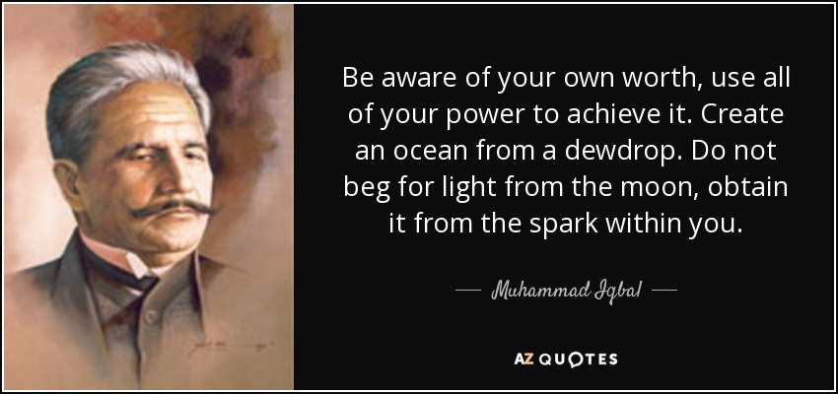

Slide 9

Summary
Know your WHY!
Work SMART
BELIEVE in yourself!

Slide 10


Thank You
ANSA EISA AHMED
Email address:
ansa@hopebereavementsupport.com
Website address:
www.hopebereavementsupport.com

