Slide 1
Languages in the community
Week 3
Karen HUMPHRIES & Shuwen Wang

Slide 2
Brief introduction
Karen
Shuwen

Slide 3
Chinese language
How did it feel to learn a new language in the environment it is spoken?
Activity 1:
Practice some of the Chinese. (Shuwen)

Slide 4
Speaking Chinese…..Shuwen

Slide 5
https://www.youtube.com/watch?v=WEHk9gJA_6k&ab_channel=Fengjing

Slide 6
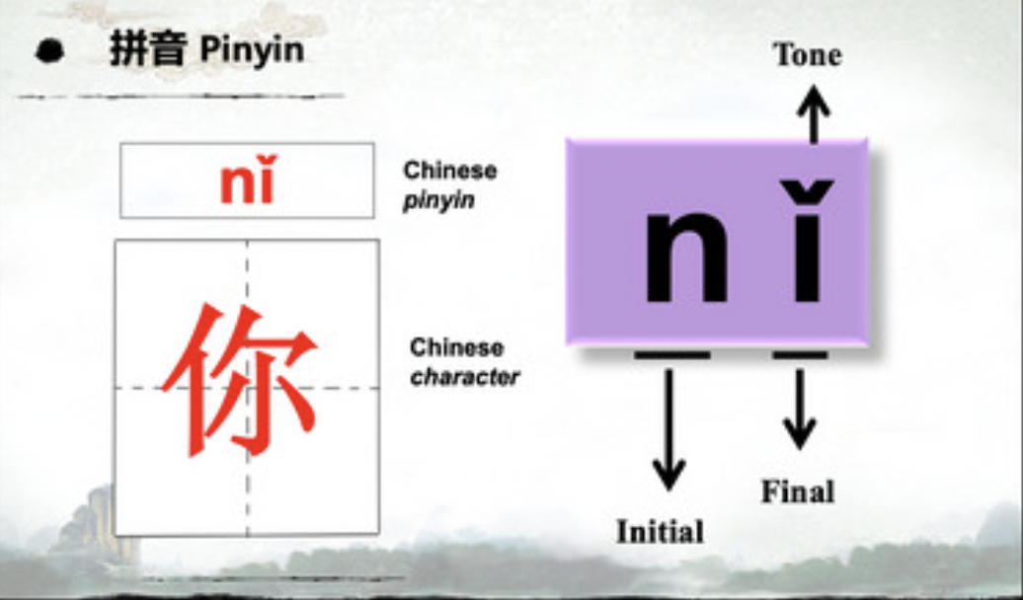
Greetings‎
1. Hello!Nǐ hǎo 你好！
Hello! 你好! Nǐ hǎo! What's your name? 你叫什么名字？ Nǐ jiào shénme míngzì ? My name is… 我叫… Wǒ jiào ..... Goodbye! 再见 ! Zài jiàn !

Slide 7
Greetings‎ 2. Hěn gāoxìng rènshì nǐ！很高兴认识你！
Happy to meet you! 很高兴认识你！ Hěn gāoxìng rènshì nǐ！ Happy to meet you too! 我也很高兴认识你! Wǒ yě hěn gāoxìng rènshì nǐ! Thank you! 谢谢你！ Xièxie！

Slide 8
See you later

Slide 9
Create a dialogue in pairs
10 minutes to prepare/ practice
Feedback
If you need further phrases ask Shuwen!!!!!!

Slide 10
Colours
Red 红色hóng sè
Blue 蓝色lán sè
Yellow 黄色huáng sè
Green 绿色lǜ sè
Pink 粉红色fěn hóng sè
Orange 橙色chéng sè
Purple 紫色zǐ sè
Brown 棕色zōng sè
Black 黑色hēi sè

Slide 11
How does Chinese compare to English and the other languages that have been presented ?
Discuss in groups
Feedback
1
2
3

Slide 12
Let’s check the activity
Activity 2:
Discuss the ‘results’ of the languages/voices exercise.

Slide 13
A language portrait in multilingualism
For more than 25 years so-called language portraits (see below) graphic visualizations of the linguistic repertoire using the outline of a body silhouette – have been used, in schools and other educational institutions, to initiate processes of language reflection and to promote sensitivity in dealing with multilingualism
They are now increasingly employed as a research tool investigating how speakers themselves experience and interpret their distinct varieties of speaking in one language

Slide 14
Why use a body ? Body image as a frame for metaphors
The success of the language portrait as a method is due not least to the fact that language is (also) a bodily phenomenon and that this dimension is addressed by the use of the silhouette. The art scholar Martin Schulz (2005) views the body as an important reference point in pictorial representations, because it is an interface between the inner and outer world, between subjects who see pictures and, in turn, objects that are seen as pictures. The metaphorical transformation of the body into a picture facilitates, in his opinion, a momentum of self-distancing, which makes it possible to experience oneself as one’s counterpart.

Slide 16
A language portrait in multilingualism
Choose colours/symbols that fit the different languages and modes of speaking that have a particular meaning for you.
Head as the place of reason,
Stomach as the place of emotions,
Heart as the location of intimacy
Hand as the site of social activity.
Symbols (national flag) or ornaments are also frequently used.
Colours, common connotations (e.g. red for the emotional, blue as a ‘cool’ colour, light for what has a positive, dark for what has a negative connotation), but also because they are associated with personal preferences (favourite colours) or aversions.
The way in which a colour is experienced is up to a certain point historically-culturally contiguous but it is not possible to match colour meanings and preferences to individual ‘cultures’.
For a single person one and the same colour may be associated with multiple connotations, green was simultaneously associated by several participants with hopeful, poisonous, bitter and soothing.
What individual elements of visualization represent and what relationship they have to one another can, in the case of language portraits, not immediately be discerned from the picture, but only be revealed through the interpretation that is given by the author

Slide 17
Complete now the body (10 MINUTES)
Pens PROVIDED

Slide 18
In groups discuss your picture individual elements cannot immediately be discerned from the picture, but can only be revealed through the interpretation that is given by the author
FINDINGS????
1
2
3
4

Slide 19
Features of your own accent (Preparation task)
Activity 3:
Discuss IN GROUPS features of your own accent.
Modifying your accent..why?

Slide 20
Activity from prepare Listen to a presentation which offers insight into how culture and personality can affect how Chinese students learn the English language
Purpose
By completing this activity , you should have a better understanding of how to communicate with Chinese students.
Questions Listen to the video and complete a written task
Spark Culture is a major aspect of Chinese life and it reflects in their personalities and consequently how they learn and communicate with users of other languages. Strategies can be developed to assist Chinese learners to develop their communication skills here in England.
Individual Contribution After listening to the video the task to complete is
Write 150 discussing what you can do to facilitate communication with Chinese language learners
Or Produce a leaflet showing advice on how to communicate with Chinese language learners

Slide 21
Feedback
Comments/ discussion

Slide 22
Practice delivering instructions/giving information using ‘new’ voice
Modifying regional accents to ensure understanding

Slide 24
Give instructions on how to do…
With the context ……your work place….
give typical instructions of how to do something to your partner with your new ‘voice’
FEEDBACK
How did you feel?

Slide 25
Conclude:
Feedback from session
How do you feel now about the Chinese language?
How do you feel about communicating with Chinese people?
How do you feel about your own ‘voice’?
After this session will you make any changes?

