Slide 1
Languages in the Community
Session 6
Tim Leigh
Senior Lecturer Language Centre

Slide 3
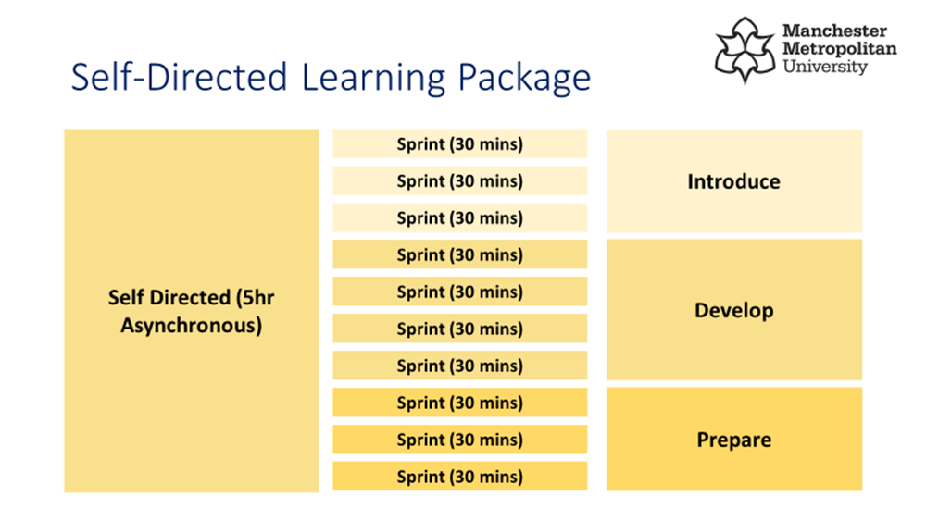
5 hours of self-study per week

Slide 4
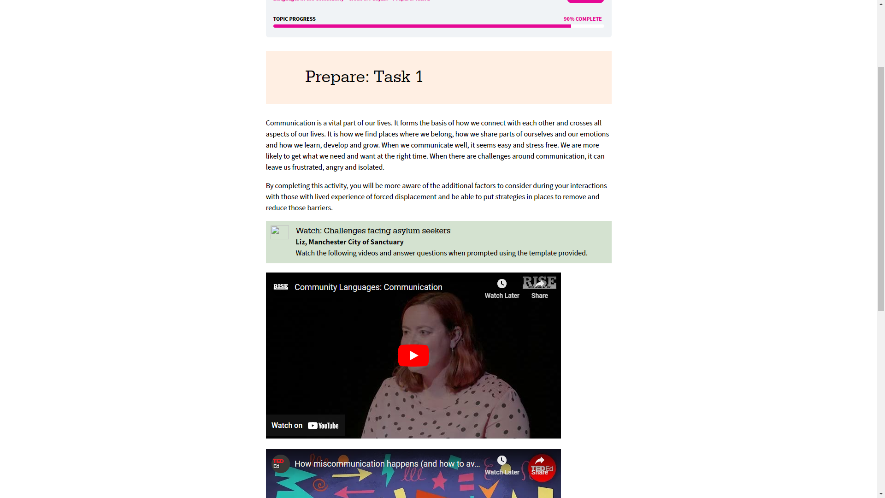
Week 6

Slide 5
Languages in the Community
Weeks | Content | Language | Workshop
Week 1 (25/1) | Multilingualism | Urdu | Tim / Momna
Week 2 (1/2) | Language & Culture | Arabic | Tim/Ahmad
Week 3 (8/2) | Language & Identity | Mandarin Chinese | Karen / Shuwen
Week 4 (15/2) | Communication | Bengali | Tim / Liz
Week 5 (22/2) | Miscommunication |  | Tim / Tony
Week 6 (1/3) | Language as a gatekeeper | Polish | Ahmad / Tim / Przemyslaw
Week 7 (8/3) | Optional online drop in (assessment support)
Week 8 (15/3) | Optional online drop in (assessment support)
Week 9 (22/3) | Assessment deadline: Wednesday 22nd March

Slide 6
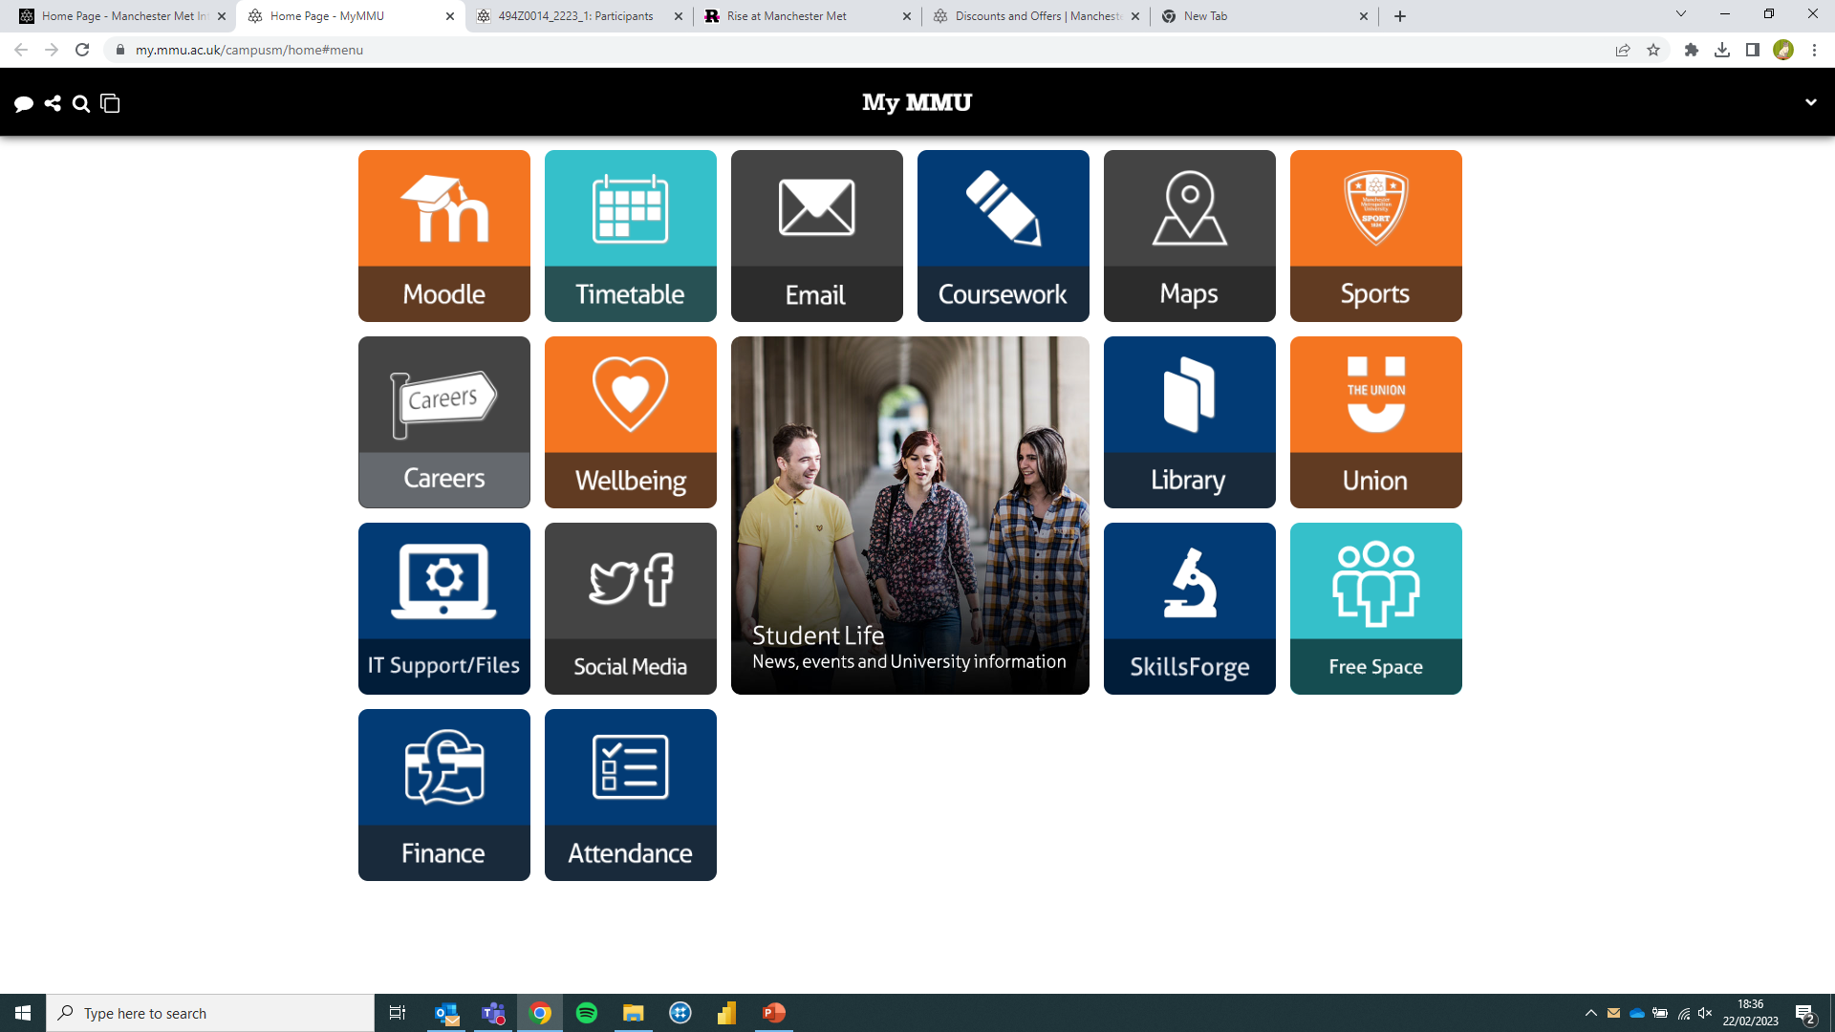
MMU Systems

Slide 7
Your next steps
To schedule a 1-2-1 online tutorial with Tim (t.leigh@mmu.ac.uk) to talk through your assessment.
To submit your assessment before 9pm Wednesday 22nd March.
To await your grade and feedback (by 19th April at the latest).
To start your next unit….

Slide 8

Contact Mair if you would like change or would like more information about the unit.

Slide 9


Slide 10
Today’s learning objectives :
To review some key terminology from the 6-week content.
To get ‘a taste’ of Polish.
To talk through next steps (assessment drafts, the marking criteria, and the submission link).

Slide 11

terminology
Rules:
- You have to explain the word, but you cannot say the word.
This word means when someone can speak two languages fluently….
Bilingual (ism)

Slide 12
terminology
Your turn:
Can you create 2 more ‘cards’ with new terminology we have covered from the course?

Slide 13
Scenario Task 1
Olga:
Olga is the mother to Piotr, a new child at your workplace. Olga’s first language is Polish.
A new colleague got into a ‘heated discussion’ with Olga.
You believe this is because of cultural/language issues. You have been asked to speak with the new colleague about this.

Slide 14
Scenario Task 2
Mo:
Mo is the father to Maisie, a new child at your workplace. Mo’s first language is Urdu and he has limited English. He arrived in Manchester as an asylum seeker 3 months ago. Mo is worried that Maisie will not settle. This is her third place of learning in three months.
You have been asked to prepare a new colleague on meeting Mo and Maisie for the first time.

Slide 15
Scenario Task 3
Layla:
Layla is the mother to Abdullah, a new child at your workplace. Layla’s first language is Arabic and they have very limited English.
You believe Layla and Abdullah have experienced trauma related to their experiences as refugees.
You have been asked to give guidance to a new colleague.

Slide 17
Creating an Artefact
The marking criteria

Slide 18
Marking Criteria
 | 15 CREDITS
 | LO1: Apply understanding of the diversity which exists within the ESOL term. |  | LO2: Respond to the social and emotional experiences of those with no/low English language proficiency |  | LO3: Select and apply strategies to support individuals across language barriers.
 | Understand | Usability | Identify | Respond | Apply | Communicate
What this Means | Consider the activities you have participated in and develop an understanding of their value. | A usabile artefact has been produce which considers a specific audience yet ensures inclusion and diversity. | Identfy instances which may require a response from the interloctuor. | Consider how the input you have received can be utilised. | Apply skills to real world situations within a defined context. | Present the value of your knowledge to a specific audience using examples and an appropriate medium..

Slide 19
Marking Criteria
 | 15 CREDITS
 | LO1: Apply understanding of the diversity which exists within the ESOL term. |  | LO2: Respond to the social and emotional experiences of those with no/low English language proficiency |  | LO3: Select and apply strategies to support individuals across language barriers.
 | Understand | Usability | Identify | Respond | Apply | Communicate
Over 80 - Exceptional | Artefacts demonstrate an advanced, expert understanding of diversity within ESOL. The knowledge which is presented is relevant to the chosen setting and so can be applied to aid communciation. | Artefacts demonstrates thorough consideration of the user. It has been crafted with thought about accessibility and inclusion, to ensure a diverse audience can learn from it effectively. | Students have expertly identified entirely appropriate instances in which a response to a language barrier may be needed in a particular setting. These have been effectively organised in a way which makes them accessible and engaging to the audience. | Students have expertly identified entirely appropriate responses to language barriers which may be needed in a particular setting. These have been effectively organised in a way which makes them accessible and engaging to the audience. | Artefacts are clearly and creatively related to real world situations and relevant examples to the chosen setting have been given. The context is clearly evident and the medium is highly appropriate. | Artefacts have been created with a specific audience in mind. Communication is authentic and highly appropriate to that audience, and there is a consciously creative interconnection between medium and message throughout.

Slide 20
Your Artefact
How can you show ‘diversity in ESOL’?
How can it ‘aid communication’?
How can you demonstrate you have considered the audience?
How can you show an ‘appropriate instance’ of a language barrier in a specific setting?
How can you relate it to a real-world setting?
How can you show it relates to a specific audience?

Slide 21
Your Artefact
Try and buddy the new child up with a friend so they have a friendly face.
Cultural stereotypes can lead to discrimination. Be careful with this.
Trauma can be represented in a number of ways like sudden misbehaviour which is not aligned to their character.
Could you suggest additional language/content for each sentence?

Slide 22
Next steps
Please contact Tim in the next week via t.leigh@mmu.ac.uk to arrange a 1-2-1 online tutorial.
We can talk through your draft and how to submit…

Slide 23
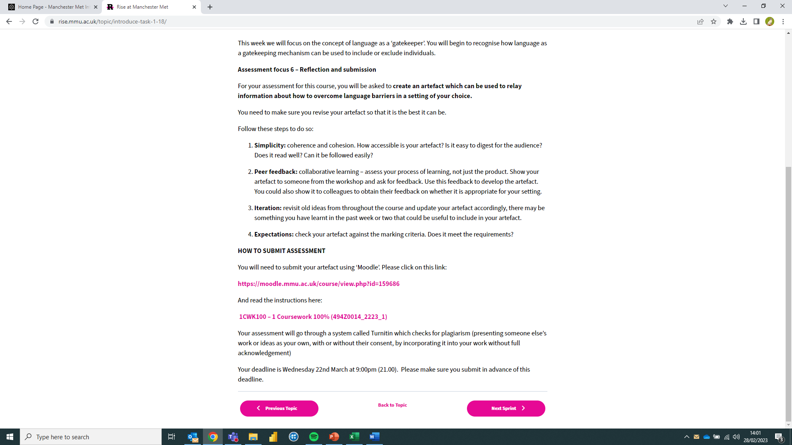

Slide 24
Language grading
2

Slide 25

What is language grading?

Slide 26
Language grading
Language Grading is the way we manipulate our language (written and verbal) to ensure the person we are communicating with understands.
We naturally grade our language all the time; imagine the difference between how you speak to a child compared to how you speak in an job interview. You can employ these skills when communicating with people who have varying levels of language proficiency.

Slide 27

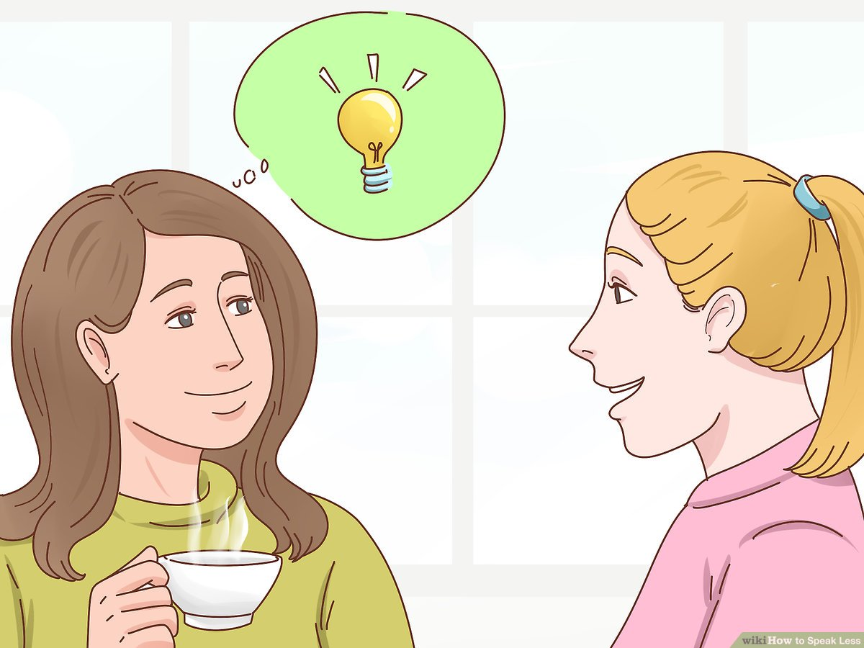
Speaking louder
My shower broke and I don’t I know how to fix it!
Sorry! I didn’t understand what you said.

Slide 28
What was covered in the course?
1- Complex sentences.
Simple sentence(s): Dan ate a huge piece of cake. He got a stomach ache.
Complex sentence: After Dan ate a huge piece of cake, he got a stomach-ache.
2- Choice of lexis
idioms, phrasal verbs and colloquialisms
3- Paralinguistic Features
body language, gestures, facial expressions
4- Concept check questions.
5- suprasegmental features.

Slide 29
Features of suprasegmental speech
Suprasegmental features are often regarded as the "musical" aspects of speech.
1- I want to eat.
2- Please do it.
3- Get on.
4- Not at all.
5- It’s no joke.
6- Tell him.
1- I want to/ w/eat.
2- Please do/ w/it.
3- Get on. ( geton )
4- Not at all. ( notatall )
5- It´s no joke. ( snow joke)
6- tell (h)im.

Slide 30
Read this text which shows someone giving instructions. Imagine that you are talking to someone whose English is not very advanced. What would you change/modify to make this text simpler?
Right, let’s kick off by having a look at exercise 46. What you need to do is fill in the gaps with the words underneath the text. It’s no big deal if you don’t get them all off the bat. There are some that are dead hard. But do what you can if that’s okay. I’ll give you around 10 minutes to do this. Work with the person sitting next to you if that helps, but you can fly solo if you want. 5 minutes to get this done. Off you go. Do you understand?

Slide 31
Complex sentences.
1- What you need to do is fill in the gaps with the words underneath the text
2- Work with the person sitting next to you if that helps, but you can fly solo if you want
1- Fill in the gaps with the words underneath the text.
2- Work with the person sitting next to you. But you can fly solo if you want
Choice of lexis
Phrasal verbs: kick off; fill in
Idioms: off the bat
3- Colloquialisms: no big deal; dead hard; off you go.
1- start / complete
2- immediately
3- don’t worry, dead hard, very difficult, you can start.

Slide 32
Thank you

