Slide 1
Languages in the Community Session 5
Tim Leigh
Senior Lecturer Language Centre

Slide 3
Languages in the Community
Weeks | Content | Language | Workshop
Week 1 (25/1) | Multilingualism | Urdu | Tim / Momna
Week 2 (1/2) | Language & Culture | Arabic | Tim/Ahmad
Week 3 (8/2) | Language & Identity | Mandarin Chinese | Karen / Shuwen
Week 4 (15/2) | Communication | Bengali | Tim / Liz
Week 5 (22/2) | Miscommunication | Polish | Tim / Tony
Week 6 (1/3) | Language as a gatekeeper | Punjabi | Ahmad / Maham
Week 7 (8/3) | Optional online drop in (assessment support)
Week 8 (15/3) | Optional online drop in (assessment support)
Week 9 (22/3) | Assessment deadline

Slide 4
5 hours of self-study per week

Slide 5
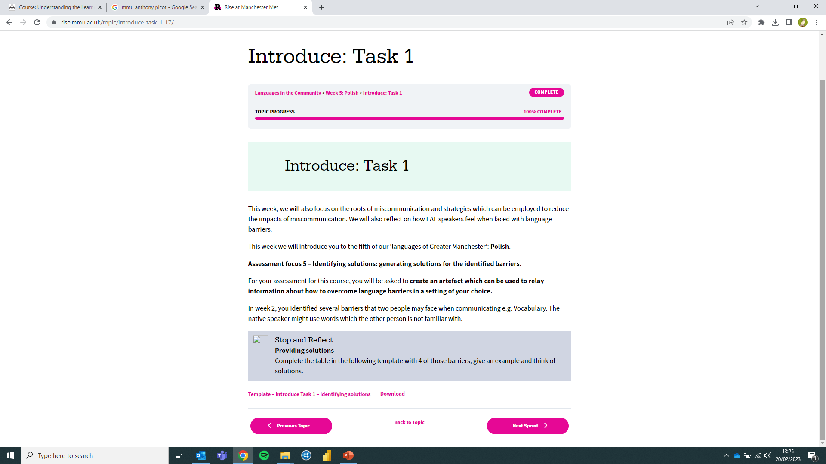
Week 5

Slide 6
Anthony (Tony) Picot,
Senior Lecturer,
TESOL and Applied Linguistics.
Notes:
I’ve been involved in education for around 13 years, first of all working as a primary teacher, then moving overseas to teach English as a Foreign Language, which I did until 2015. Through this work I have witnessed the barriers that many people face trying to access education, as well as the importance it has on equipping people for the difficulties they encounter throughout their lives. Having lived in South America, Egypt, Thailand and Qatar, as well as travelling extensively through S.E Asia, Central America and Africa, I am privileged to have a unique understanding and awareness of different cultures and value the need to work and live in ways which welcome and support diversity.
Volunteering in the ‘Jungle’ refugee camp in Calais, France, made a real impact on me and changed the direction of my MA studies. I decided to focus on education and refugees and analyse the support teachers have in terms of understanding the refugee experience. My research showed that teachers don’t feel they have the knowledge or confidence to facilitate their students’ awareness or understanding of the current situation despite them wanting to challenge prejudice and explore the issue further. Partly as a result of this, I became more passionate about supporting the integration of refugees and asylum seekers, as well as raising the awareness of the refugee journey to those who have limited interaction with newcomers to the UK. By promoting understanding and questioning perceived notions, I hope to create a space where genuine dialogue and engagement can take place. Through my work with Manchester City of Sanctuary, I aim to do this. Highlighting commonalities and understanding the lives of others is the first step towards recognising our shared humanity and working towards a world where everyone is made to feel welcome and at home.

Slide 8
Today’s learning objectives :
To experience being an ‘absolute beginner’ learner of a new language.
To review the week 5 content.
To look through ‘language and miscommunication’ in line with the assessment task (creating an artefact).

Slide 9
terminology
Cognitive overload
Peer learning
eliciting
Speech Emergence
Language script
Pre-production (the silent period)

Slide 10
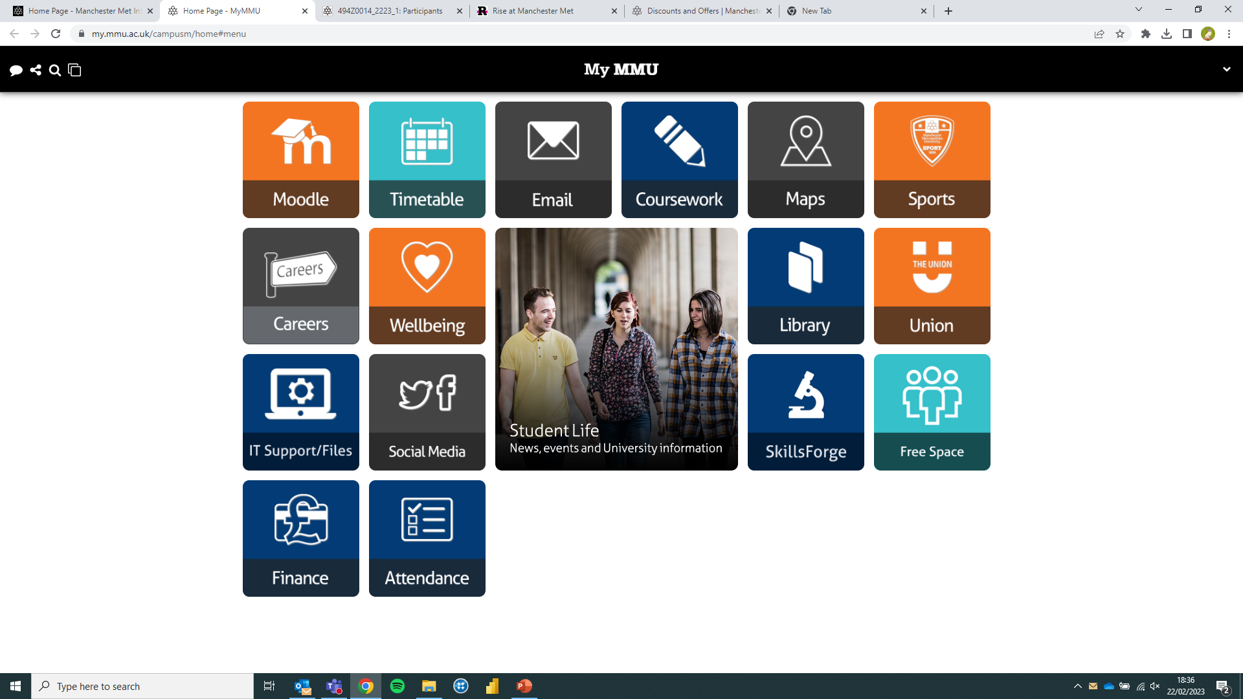
MMU Systems

Slide 11
MMU Discounts!
https://www.mmu.ac.uk/student-life/finance/discounts-and-offers#ai-65186-5

Slide 13
Intercultural misunderstandings
Causes
Ethnocentrism
Different definitions of right and wrong
Communication Differences
Exclusive Workplace Practices
the attitude that one’s own group, ethnicity, or nationality is superior to others
The opposite of an inclusive workplace, i.e. a cause of conflict
what is considered to be right or wrong differs among cultures.
differences in speech patterns, etiquette, and verbal and nonverbal communication.
Have you got an example to provide? And a solution you had?

Slide 14
What are Communication Barriers?
Language
Culture

Slide 15
Communication Barriers
Barrier | Example | Solution
Vocabulary. The native speaker might use words which the other person is not familiar with. | Go down the ginnel and go left at the end. | Watch out for cues to show lack of understanding. Use high frequency vocabulary. Make use of synonyms e.g., alley way. Check they have understood.

Slide 16
Communication Barriers
Barrier | Example | Solution
Vocabulary. The native speaker might use words which the other person is not familiar with. | Go down the ginnel and go left at the end. | Watch out for cues to show lack of understanding. Use high frequency vocabulary. Make use of synonyms e.g., alley way. Check they have understood.
Can you create three more examples?

Slide 17
Creating an Artefact
Some ideas:
Use some of the key terms / useful language from the unit.
Provide definitions if possible.
Provide ‘instructions’ or ‘cheat sheet’ if required.
Feel free to use personal examples, experiences, knowledge to support.

Slide 18
Thank you

