Slide 1
Languages in the Community
Session 4
Tim Leigh
Senior Lecturer Language Centre

Slide 3
Today’s learning objectives :
To review the week 4 content.
To discuss the area of trauma and language.
To look through ‘language and the workplace’ in line with the assessment task (creating an artefact).

Slide 4
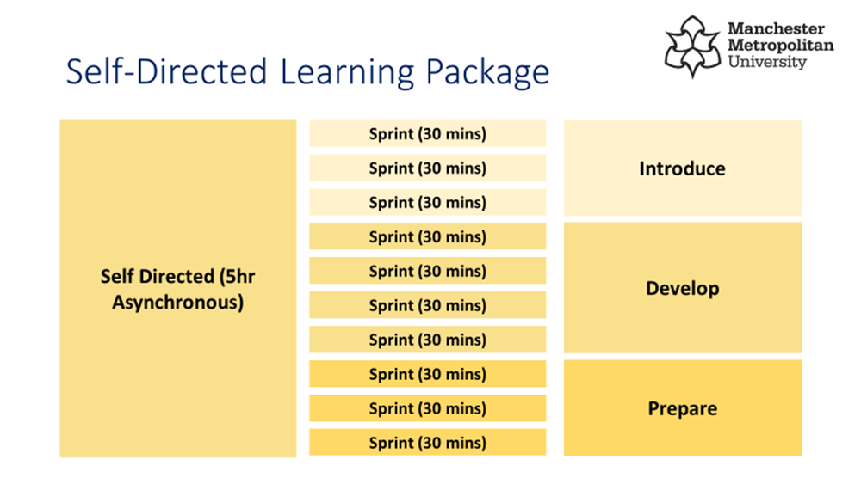
5 hours of self-study per week

Slide 5
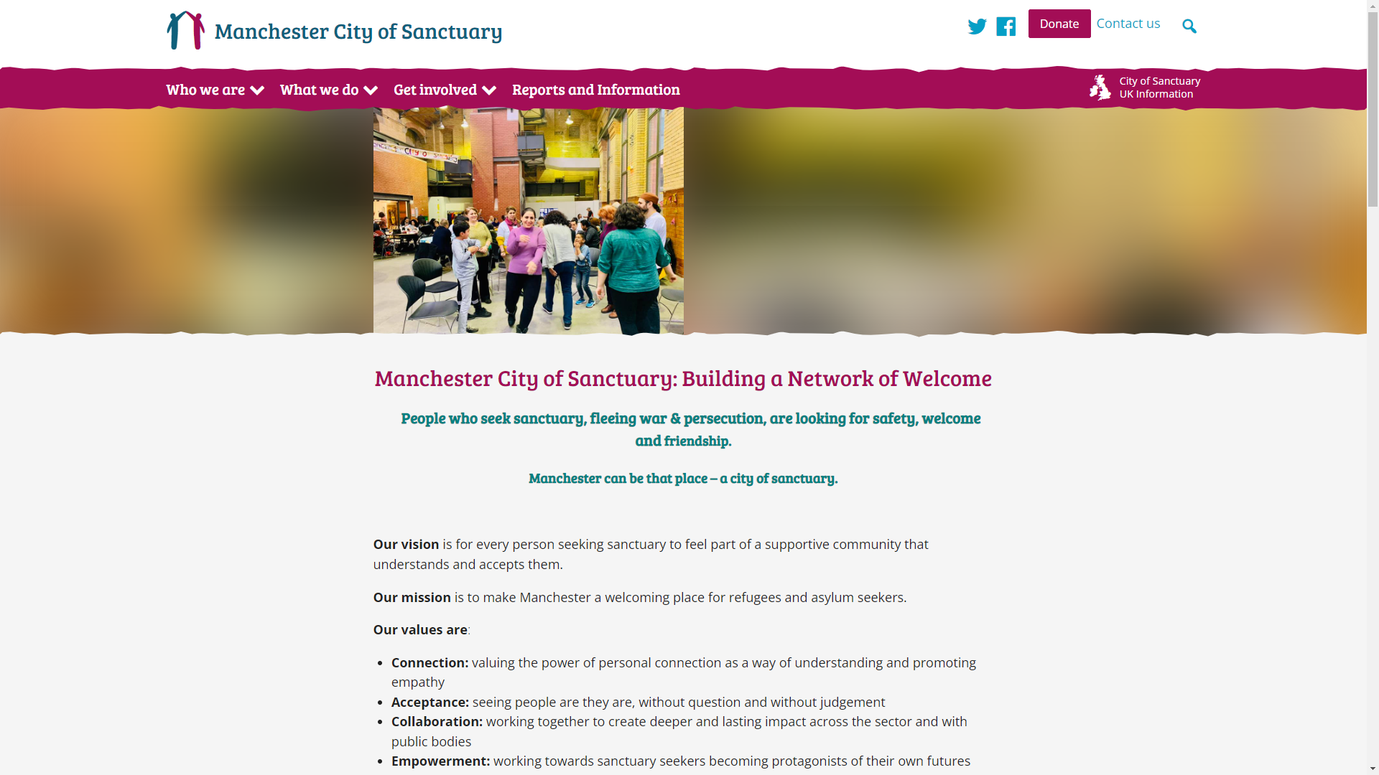
https://manchester.cityofsanctuary.org/

Slide 6
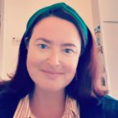
Liz Hibberd,
Strategic and Partnership Lead
Notes:
I’ve been involved in education for around 13 years, first of all working as a primary teacher, then moving overseas to teach English as a Foreign Language, which I did until 2015. Through this work I have witnessed the barriers that many people face trying to access education, as well as the importance it has on equipping people for the difficulties they encounter throughout their lives. Having lived in South America, Egypt, Thailand and Qatar, as well as travelling extensively through S.E Asia, Central America and Africa, I am privileged to have a unique understanding and awareness of different cultures and value the need to work and live in ways which welcome and support diversity.
Volunteering in the ‘Jungle’ refugee camp in Calais, France, made a real impact on me and changed the direction of my MA studies. I decided to focus on education and refugees and analyse the support teachers have in terms of understanding the refugee experience. My research showed that teachers don’t feel they have the knowledge or confidence to facilitate their students’ awareness or understanding of the current situation despite them wanting to challenge prejudice and explore the issue further. Partly as a result of this, I became more passionate about supporting the integration of refugees and asylum seekers, as well as raising the awareness of the refugee journey to those who have limited interaction with newcomers to the UK. By promoting understanding and questioning perceived notions, I hope to create a space where genuine dialogue and engagement can take place. Through my work with Manchester City of Sanctuary, I aim to do this. Highlighting commonalities and understanding the lives of others is the first step towards recognising our shared humanity and working towards a world where everyone is made to feel welcome and at home.

Slide 8
Communicating and Engaging with People who have experienced Trauma
(Adverse Childhood Experiences)
Liz Hibberd

Slide 9
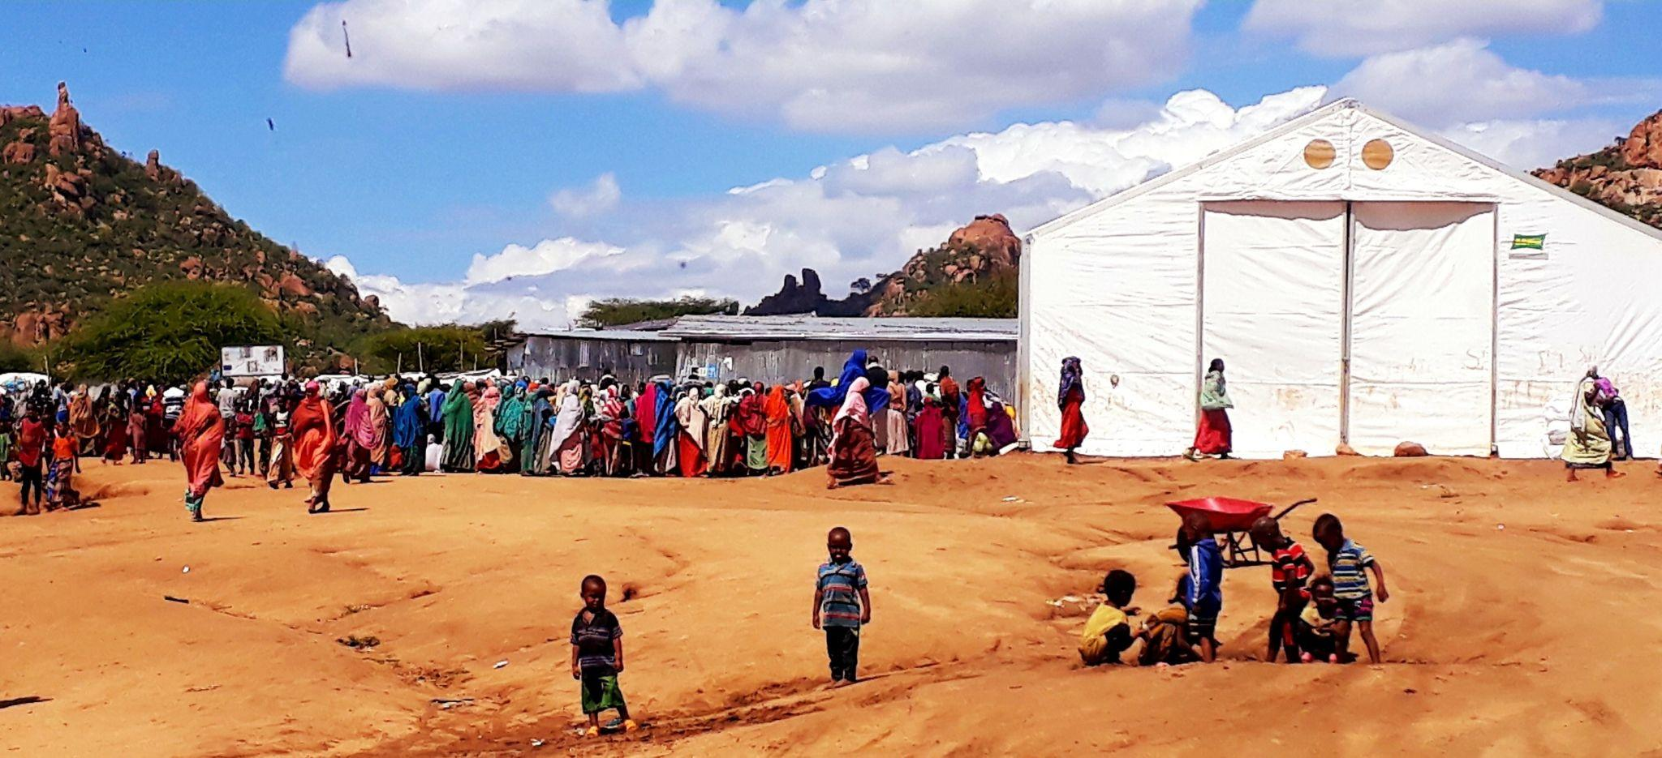
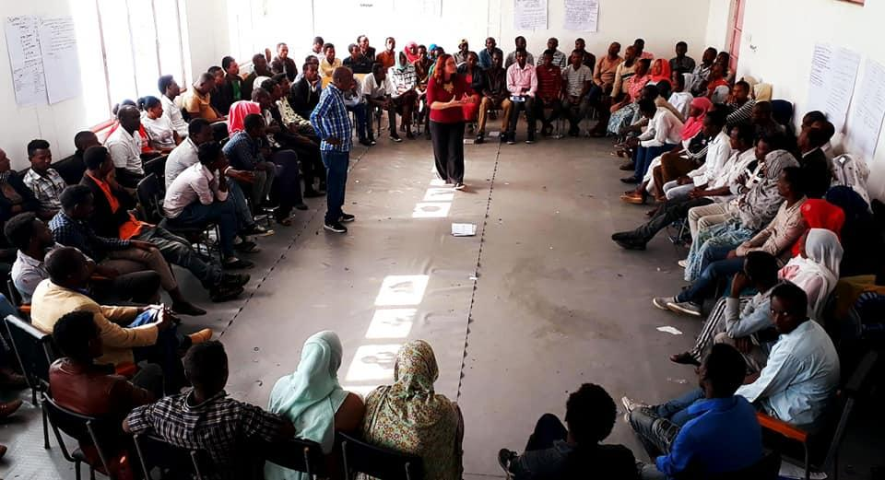
Teacher & Trainer
Volunteer in the ‘Jungle’, Calais
Lead Educator on The School Bus, Calais
Trainer in Refugee Camps in Greece
Community Mentor at Safe Passage - UASC
MA in Development Education
Psychosocial Support Specialist – Ethiopia, UNICEF
Manager at Manchester City of Sanctuary

Slide 10
Trauma
Trauma is the lasting emotional response that often results from living through a distressing event. Experiencing a traumatic event can harm a person's sense of safety, sense of self, and ability to regulate emotions and navigate relationships.
Adverse Childhood Experiences
Potentially traumatic events that can have a negative and lasting impact on health and wellbeing and tend to have happened before a person is 18.
These experience range from physical, emotional, or sexual abuse and can include parental divorce or parental imprisonment

Slide 11
Trauma
Trauma is not what’s wrong with you but what’s happened to you
**Brain protects you from feeling the same feelings again**
The trauma you experience dictates who you are and your reality - but not indefinitely and not with intervention. The hope is that trauma becomes PART of your story, NOT your reality.

Slide 12
ACE’s
Research shows that the adversity you experience as a child can affect how your long term stress response functions, leading to long-term changes in our brains and bodies and leading to health problems as an adult.
Experiencing 4 or more ACE’s is associated with a higher risk of heart disease, stroke, cancer, COPD, Alzheimers, diabetes and suicide.

Slide 13
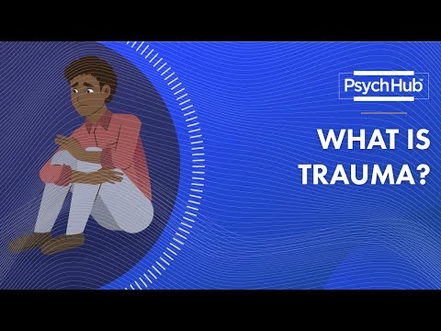
Watch this……

Slide 14
What contributes to someone’s response to trauma?
Culture
Values
Belief system
Network of support
Development stage/age
Feelings of safety
Being out of their window of tolerance
Not having any coping strategies

Slide 15
Responses to trauma
Fear
Anxiety
Humiliation
Shame
Guilt
Post Traumatic Stress Disorder

Slide 16
How might trauma show up for people?
Being upset/angry
Feeling nervous
Hyper vigilance
Upsetting thoughts
**These can worsen with thoughts or reminders of the event so people will do what they can to avoid them
** However can also be triggered by no external reason
Confusion
Feeling detached
Poor sleep
Low self-esteem

Slide 17
So what’s the impact for you?
This is potentially happening while you’re trying to engage and communicate with a person about housing, healthcare, education……
It’s a barrier for you to connect with them.
Their priority will be about keeping themselves safe.

Slide 18
Trauma Informed Environments
5 elements of creating a trauma informed environment
- Safety
- Trust
- Empowerment
- Collaboration
- Control
By implementing these elements, we ensure that people are more likely to have a safe and positive experience. This is key in all areas of the work we do.

Slide 19
Essentials of TIC
• Connect – Focus on Relationships
• Protect – Promote Safety and Trustworthiness
•Respect – Engage in Choice and Collaboration
• Redirect (Teach and Reinforce)
Encourage Skill Building and Competence
(Hummer, V., Crosland, K., Dollard, N., 2009)

Slide 20
Specifically working with children
Creating a Safe Environment through Relationships
Rebecca S. Brown, LCSW suggests these strategies in working with students impacted by trauma:
• Clarify your role with the student.
• Establish yourself as a safe individual.
• Create an environment of respect.
• Give the student opportunities to make choices.
• Talk about safety and what steps you will take to help the student be and feel safe.
• Connect the student to the appropriate resources and people.
• Message to students: “You are not alone.”

Slide 21
Creating a Safe Environment
Some safety approaches for the classroom:
• Have a predictable environment with clear expectations for behaviour
• Have structure during the class day, try not to deviate from it often
• Establish a quiet, safe place in the classroom for students to go when they are feeling overwhelmed. It should be a comfortable space away from others, with comfortable furniture, blankets and pillows.
• Have some sensory materials for students, such as a small rubber ball they can squeeze, stuffed animals, pillows with different types of fabric, pipe cleaners, rocks, crystals, play dough or clay, paper for scribbling, colour markers/pencils, puzzles, etc.
• Have pleasant colours, pictures of nature, cute animals, etc. in the classroom that students can focus on when dysregulated
• Incorporate music into the classroom that is playing in the background, rhythmic sounds

Slide 22
Behavioural Strategies for Trauma Impacted Students
• Practice active listening with students and demonstrate empathy
Use of specific praise like-- “You did very good sharing today” vs “Good job today.”
• Active ignoring of negative behaviour
• Consistent expectations and behaviour plans that are based on rewards systems, not punishment.
• Do collaborative problem-solving with students
• Teach Feelings Expression and Coping — Identify and label emotions and feelings.
• Use of scales and “thermometer” to rate emotion intensity – visual guide
• Recognize that change happens very slowly.
• Know that you may never see the outcomes of your efforts.

Slide 23
Think about and discuss…
Your experiences of working with people who have experienced trauma and/or ACEs
What have been the biggest challenges?
What could you incorporate into your work/your role to support people (and yourselves) more effectively?
What has been the most useful from today’s input?
What will you try and use?

Slide 24
terminology recap
ACE
Vicarious
trauma
Window of tolerance
Hyper-vigilance
TIC

Slide 25
Speech acts
- Morning.
- Morning.
- How are you doing?
Yeah fine thanks.
There’s milk in the fridge.
Great. Fancy one?
Just had one thanks.

Slide 26
Speech acts across cultures
Speech acts refer to the actions or functions performed in saying something, such as greeting, inviting, offering, ordering, requesting and so forth.
The actions/functions of our speech acts can be direct when our utterances communicate the literal meaning of our words,
or indirect when our utterances communicate a different meaning from the surface meaning.

Slide 27
Speech acts across cultures
The strategies that people use while performing speech acts can lead to misunderstanding, especially when these strategies are different across languages.
Speakers of English as a second language may transfer some speech acts strategies from their first language that are inappropriate.

Slide 28
Speech acts
English speaker: Would you like some drinks?
Italian speaker: Give me a glass of mineral water with no ice.

Slide 29
Speech acts
Italian speaker: I have brought you a brioche
Japanese speaker: Sorry

Slide 30
Speech acts across cultures
Can you think of any social encounters where misunderstanding occurred due to the language (and/or speech acts)?

Slide 32
Languages in the workplace
Did you watch the recording from the Principal at Westwood Academy (a primary school in Oldham)?
Considering the events that Westwood Academy hold, what similar workshops or events could you organise in your workplace?
How could you promote the languages spoken by the staff in your workplace?

Slide 34
Creating an Artefact
For your assessment for this course, you will be asked to create an artefact which can be used to relay information about how to overcome language barriers in a setting of your choice.
Look at the 3 artefacts which present some information. Write some of the strengths of each artefact in how they can communicate nonverbally.
Which of these would be most appropriate for your setting and audience? Why? (Consider the format, not the information).

Slide 35
Creating an Artefact
What are your draft ideas?

Slide 36
Thank you

