Slide 1
Languages in the Community
Session 2
Tim Leigh
Senior Lecturer Language Centre

Slide 3
Languages in the Community
Weeks | Content | Language | Workshop
Week 1 (25/1) | Multilingualism | Urdu | Tim / Momna
Week 2 (1/2) | Language & Culture | Arabic | Tim/Ahmad
Week 3 (8/2) | Language & Identity | Mandarin Chinese | Karen / Shuwen
Week 4 (15/2) | Communication | Bengali | Tim / Liz
Week 5 (22/2) | Miscommunication | Polish | Tim / Tony
Week 6 (1/3) | Language as a gatekeeper | Punjabi | Ahmad / Maham
Week 7 (8/3) | Optional online drop in (assessment support)
Week 8 (15/3) | Optional online drop in (assessment support)
Week 9 (22/3) | Assessment deadline

Slide 4
Today’s learning objectives :
To review the week 2 content.
To continue to gain familiarity with the unit’s content and its assessment.
To ‘taste’ the week 2 language: Arabic.

Slide 5
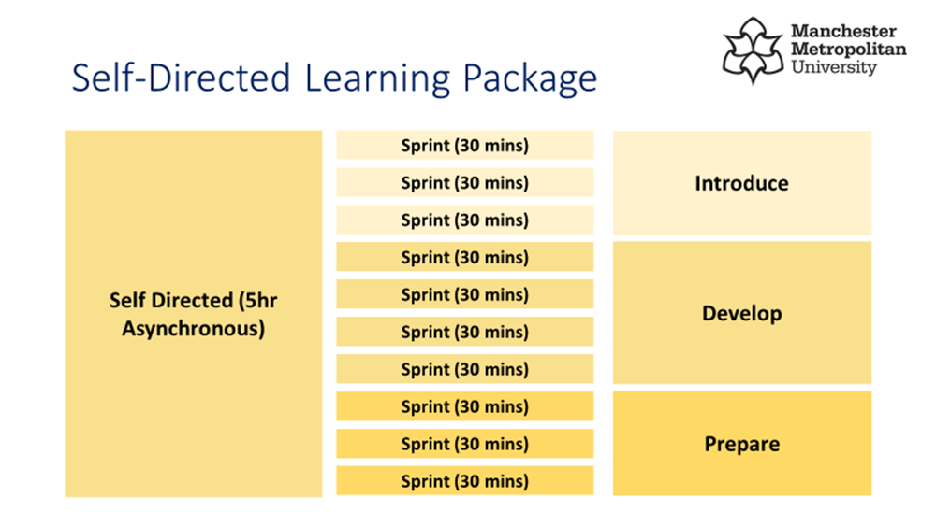
5 hours of self-study per week

Slide 6
‘Language as the key’

Slide 7
Style
Genre
Appropriacy
Do you mind?
Grammar
Lexis
Phonology

Slide 8
Language: A complex sociolinguistic system
Socio-linguistic
It is influenced by social norms
Context is always important
Linguistic rules (correct and incorrect structures)
Rules about sounds and words
Style
Genre
Appropriacy
Grammar
Lexis
Phonology

Slide 9
Matching:
Style
A: the vocabulary of a language.
B: the set of structural rules governing the language.
Genre
Appropriacy
C: the choice of words used when we speak or write.
Grammar
D: The sounds of a language.
Lexis
E: whether the language is suitable for the context it is being used in.
Phonology
F: a term used to classify types of spoken or written discourse.

Slide 10
What is the language error?
Grammar
I spended my last £10 in the shop last night.
[email] Dearest Tim, it is with the heaviest of hearts that I plead for your forgiveness for my absence during last week’s workshop.
My favourite chocolate is an apple.
Yo teacher, I am absolutely bursting. Can you give me like 2 mins?
Go straight ahead and the building is on your light hand side.
Style
Lexis
Appropriacy
Phonology
Style
Genre
Appropriacy
Grammar
Lexis
Phonology

Slide 11
Style
Genre
Appropriacy
How would you answer these questions to a non-native English speaker?
How do I start and end an email to my new boss?
What do I say if someone says “I have a doctor’s appointment this afternoon”.
How should I address my manager in English?
When is it ok to swear in English?
I said to my colleague, ‘you should stop smoking’ and he seemed upset. What should I have said?

Slide 12
‘Language as the key to integration’
Learning the host country’s language is argued to help develop a sense of belonging and reconstruct ways of life and identities (Esser, 2006).
The European Council report on the Linguistic Integration of Adult Migrants (LIAM, 2014) also addresses the strong relationship between the knowledge of a ‘host’ language and social and economic integration
The reason for unsuccessful integration is often explained by the level of proficiency in the host language (Allan, 2013).
BUT, Saygi (2019) believes Language as the key to integration is a MYTH….

Slide 13
‘Language as the key to integration’ : a myth…
Saygi (2019) argues….
responsibility for integration is wrongly assigned to migrants when language proficiency becomes the main focus of integration.
language skills may result in another layer of hierarchy in social order among migrants, distinguishing those knowing the language and those who do not.
although we may see learning the host country’s language as one of the first steps to ensure social equality and participation, it does not guarantee access to local communities.
Social conditions largely determine one’s position in society.

Slide 14
Is ‘Language as the key to integration’ a myth?
Do you believe that language fluency is an indicator of integration? Why? Can you provide an example to support your argument?
According to Saygi (2019), the way we speak implies a sense of power. To what extent do you agree with this? Can you provide an example to support your argument?

Slide 16
The Unit’s assessment
For your assessment for this course, you will be asked to create an artefact which can be used to relay information about how to overcome language barriers in a setting of your choice.
In weeks 3 and 4, the online tasks will show you examples, ask you to consider your ideas, and to encourage you to create draft ideas.
What are your initial ideas? Could it be a poster for your workplace? A leaflet for new colleagues? A welcome letter for new parents?
The deadline is 22nd March (7 weeks) so we have time….

Slide 17
Thank you

