Slide 1
Welcome to Languages in the Community
Tim Leigh
Senior Lecturer Language Centre

Slide 3
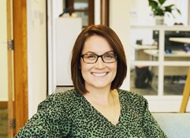
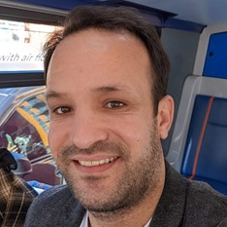
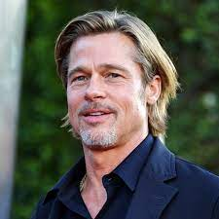
The team
Mâir Bull – Programme Co-Lead – mair.bull@mmu.ac.uk
Ahmad Al Shahma – Unit Support – ahmad.al-shahma@stu.mmu.ac.uk
Tim Leigh – Unit Leader – T.Leigh@mmu.ac.uk

Slide 4
Special Thanks to Caroline Collier!

Slide 5
Today’s learning objectives :
To introduce the unit of study and each other.
To gain familiarity with the unit’s content and delivery.
To better understand the University’s support mechanisms.
To ‘taste’ the week 1 language: Urdu.

Slide 6
Languages in the Community
What do you think we will study over the next 6 weeks?
‘To have another language is to possess a second soul’ Do you agree? Why/Why not?
If Manchester is the ‘community’, which languages do you think we will focus on?

Slide 7
Languages in the Community
Weeks | Content | Language | Workshop
Week 1 (25/1) | Multilingualism | Urdu | Tim / Momna
Week 2 (1/2) | Language & Culture | Arabic | Ahmad
Week 3 (8/2) | Language & Identity | Mandarin Chinese | Karen / Shuwen
Week 4 (15/2) | Communication | Bengali | Tim / Liz
Week 5 (22/2) | Miscommunication | Polish | Tim / Tony
Week 6 (1/3) | Language as a gatekeeper | Punjabi | Ahmad / Maham
Week 7 (8/3) | Optional online drop in (assessment support)
Week 8 (15/3) | Optional online drop in (assessment support)
Week 9 (22/3) | Assessment deadline

Slide 8
How we will study

Slide 9
Each week, your goal is to:
Complete the 5 hours of self-study on the RISE platform.
Attend the 2-hour Wednesday evening workshop.
Be prepared to discuss and share your ideas both individually and in groups.
Double homework if you haven’t had a look at week 1. You will need to complete week 2 for next Wednesday.

Slide 10
Student Support

Slide 12
A little about you…
What made you choose to join the course?
What are you most looking forward to studying?
What are you not looking forward to?
What is your background in learning other languages?

Slide 14
Manchester: City of languages
Approximately how many languages do you think are spoken by long-term residents in the Greater Manchester area?
50
100
150
200

Slide 15
Manchester: City of languages
What percentage of Manchester’s adult population are likely to be multilingual?
10%
20%
50%
70%

Slide 16
Manchester: City of languages
“Manchester’s language diversity is one of its greatest strengths”. Do you agree?

Slide 17
Manchester: City of languages
Which language is the most popular community language in Greater Manchester?
Punjabi
Urdu
Polish
Mandarin Chinese

Slide 18
Your ‘taste’ of Urdu

Slide 19
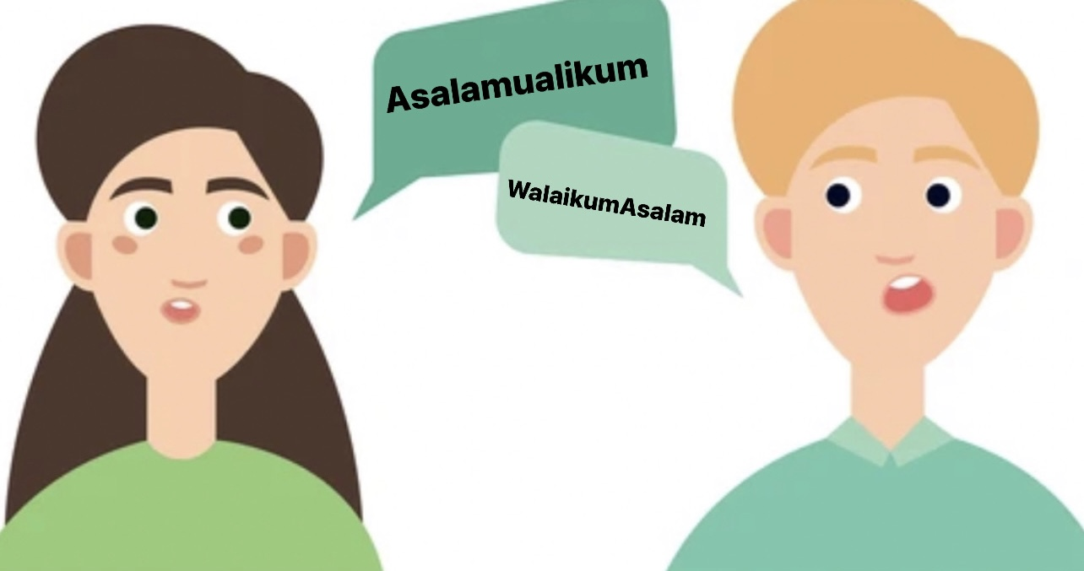
How do we greet in urdu?
-Asalamualikum [as-alam-o-ali-kum], is how we say Hi, this translates to “may peace be upon you”
-In reply to Asalamualikum we say Walaikumasalam, which means may peace me upon you too
-Or we can simply say “Salam”
.

Slide 20
How deo we introduce ourselves?
-I’m Momna so I would say “Mera naam Momna hai” which translates to my name is Momna.
-“Apsay milkay acha laga” which means nice to meet you.

Slide 21
How’re you? → ”Apka kya haal hai?”
I’m fine, thank you, and you? → “Mai theek hun, aur aap”
Goodbye → “Alvida”

Slide 22
Let’s practise some urdu
Asalamualikum
Walaikum asalam
Apka kya haal hai? (How’re you?)
Mera naam _____ hai. (My name is_____)
Alvida (Goodbye)

Slide 23
Facts about urdu
Urdu is spoken by 87 million people around the world
4 million people in the UK speak Urdu
There are many words in Urdu which are the same in English such as: sofa, cup, juice, calendar, machine, pyjamas etc
The word Thanks in English translates to Shukriya in Urdu, but unlike British/English people, Urdu speaking people don’t use it much, not because they are being rude but just because it’s uncommon

Slide 24
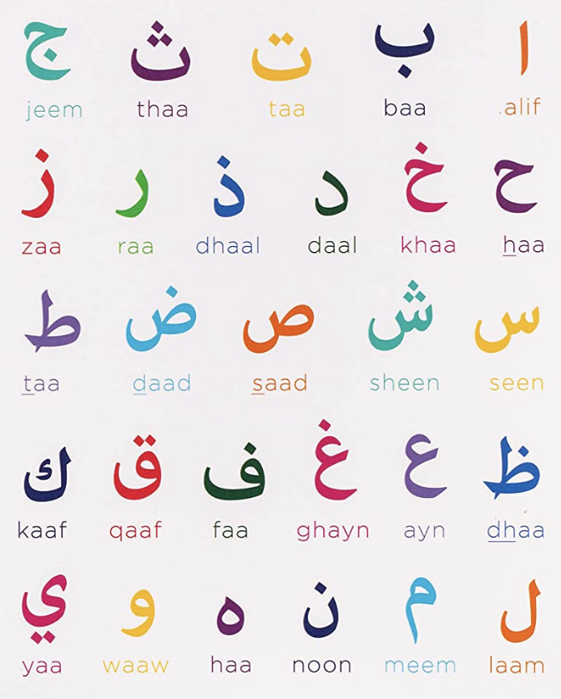
Alphabet in urdu
-Written Urdu has two versions, Roman Urdu, and Urdu.
Roman Urdu is written with the Latin script and traditional Urdu is written in Arabic script, Urdu and Arabic share the same alphabet.
-Traditional Urdu just like Arabic starts from right to left whereas roman Urdu is read and written just like English which is from left to right.

Slide 25
THANK YOU,SHUKRIYA.

Slide 26
Key Terms and Definitions
Bilingual | Can speak two languages (fluently)
Multilingual | Can speak more than two languages (fluently)
Code switching | When a person switches languages or language varieties in speech (or text)
Fluent | possesses a high level of language (speaks naturally)
EAL | English as an Additional Language
ESOL | English for Speakers of Other Languages
EFL | English as a Foreign Language
Native language / mother tongue / first language | A person’s first language
Language grading | Changing your language to suit the listener/reader, e.g. simplifying language
Accent | a person’s pronunciation
Dialect | a person’s language (or language variety), e.g. vocabulary choice, grammar, etc.

Slide 27
Thank you

