Slide 1
Welcome to early literACIES

Slide 2
Today’s session
Structure of the unit
Unit philosophy
Getting to know one another
Building our learning environment
The Early Literacies page
Defining literacies

Slide 3
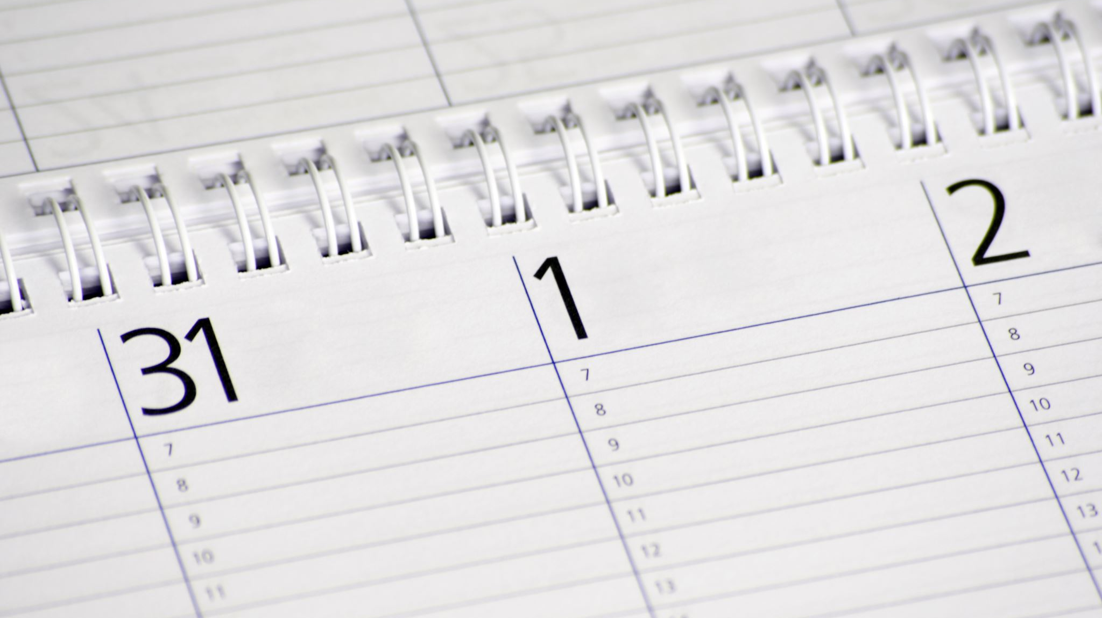
structure of the unit

Slide 4
Unit structure
Week 1 - Unit ethos and introduction: literacies in professionals’ everyday practice
Week 2 - Learning literacies – schooled approaches
Week 3 – Decentering schooled approaches
Week 4 - Doing literacies with children – from policy to practice
Week 5 – Bringing literacies to life
Week 6 – Assignment support

Slide 5
Over the next 6 weeks…
Identify the role of schooled approaches, e.g. reading, writing and vocabulary in common understandings of literacy
1
Reimagine literacy to include everyday, taken for granted spaces
2
Explore how literacy can be understood in emotional, social and physical ways
3
Understand the relationship between language, literacy, culture and background
4

Slide 6
By the end of the unit
Apply an understanding of the relationship between literacy and everyday life.
Enhance traditional theorisations of language and literacy with disruptive contemporary issues
Take an holistic approach to literacy teaching and learning in practice

Slide 7
How we will learn
Seminars
Discussions
Reading
Preparation activities
Videos

Slide 8
Your teaching team

Slide 9
Your teaching team
Mel Hall (unit lead)
Gillian Smith
Martin Needham

Slide 10
UNIT PHILOSOPHY

Slide 11
Getting to know each other
Who are you?
What are you hoping to get from this unit?
See padlet

Slide 12
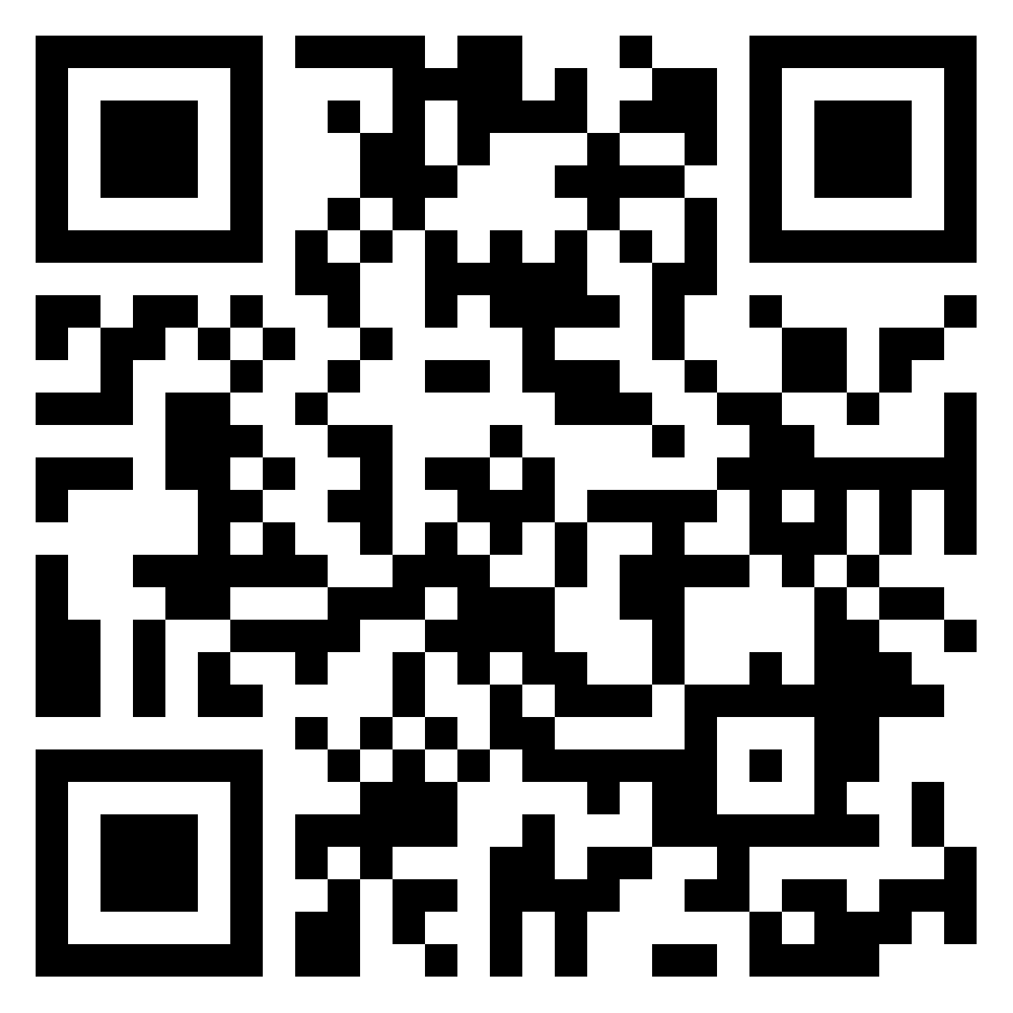
Padlet

Slide 13
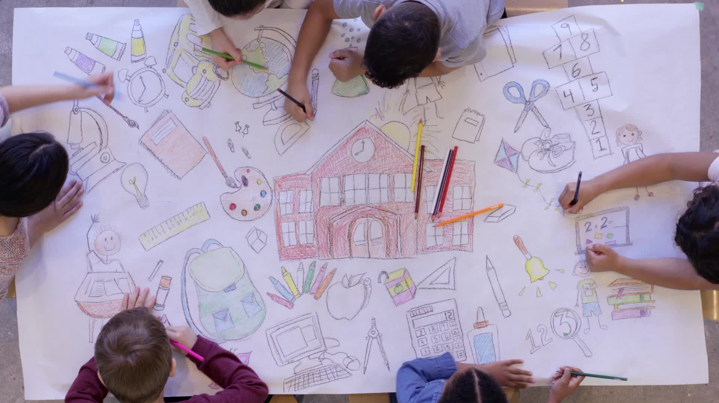
Building our learning environment

Slide 14
The rise page

Slide 15
Worries

Slide 16
Unit manifesto

Slide 17
WHAT YOU CAN EXPECT FROM ME
A supportive learning environment
Timely/considered responses to queries

Slide 18
WHAT WE EXPECT FROM ONE ANOTHER
Preparation in advance
Independent working
Collaborative working
Sharing ideas/experiences

Slide 19
Question & Answer

Slide 21
DEFINING LITERACIES

Slide 22
What does Literacy mean to you?
Post its

Slide 23
Ways we practice literacy
Post its

Slide 24
objects

Slide 25
WHAT HAVE WE LEARNED TODAY?

Slide 26
definition
LITERACY: Communicational practices that include script, talk and other modal forms (Pahl and Rowsell, 2020).
‘Literacy is about seeing, disrupting, hoping, knowing, creating and making….Literacy is too important to be reduced to a set of skills’ (Pahl and Rowsell, 2020, pp.2-4)

Slide 27
NEXT WEEK Learning literacies: schooled approaches

