Slide 1
Learning literacy: schooled approaches
Workshop 2

Slide 2
Last week
Unit introduction
Literacy as grounded in every day practices ‘literacy as a social practice’
Literacy is not simply decoding text
Reducing literacy to a mere skill is not enough

Slide 3
This unit will help us
Identify the role of schooled approaches, e.g. reading, writing and vocabulary in common understandings of literacy
1
Reimagine literacy to include everyday, taken for granted spaces
2
Explore how literacy can be understood in emotional, social and physical ways
3
Understand the relationship between language, literacy, culture and background
4

Slide 4
Reading preparation
Read chapter 1: Henning, L., 2019. Researching Early Childhood Literacy in the Classroom: Literacy as a Social Practice. Routledge. (Available via MMU Library).
Reading wars or reading reconciliation? A critical examination of robust research evidence, curriculum policy and teachers' practices for teaching phonics and reading - Wyse - 2022 - Review of Education - Wiley Online Library
Guardian article

Slide 5
This week’s workshop
Examples of schooled literacy
Phonics as a case study – some will be very familiar, some less so
What are your experiences of working in the schooled framework?

Slide 6
Martin - Introduction

Slide 7
How do you teach literacy to children?
What approaches are you familiar with?
What works?
What doesn’t?

Slide 8
The Simple View of Reading
Reading is made up of 2 processes:
Decoding (making symbols on a page into words)
Language comprehension (understanding what you read)
(Gough and Tunmer, 1986)

Slide 9
Language comprehension
The witch put a large plate of cookies on table and smiled widely at the two children.
What’s happening? How do you know?
Draw it. How did you know what to draw?
Would you eat those cookies? Why?
How do you know?

Slide 10
The Simple View of Reading
Decoding x Language Comprehension = Reading Comprehension
Might seem obvious, but previously…
Teaching practice had underemphasised Decoding.
Gough and Tunmer (1986) situate them as equally important.

Slide 11
The Simple View of Reading
Implications for practice:
Need to teach children to decode quickly.
Allows different support for Decoding and Language Comprehension, depending on what children are struggling with.
Decoding and Language Comprehension can be separated for assessment.
This leads us into phonics!

Slide 12
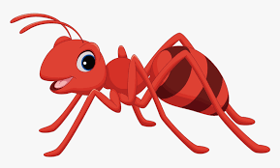
Example sounds lesson
a
First we introduce a grapheme-phoneme correspondence:
This is an “a” sound.
Like in a-a-a-a-apple.
Or a-a-a-a-ant.

Slide 13
Example sounds lesson
s a t
. . .

Slide 14
Example sounds lesson
s a t
h a t
. . .
. . .

Slide 15
Example sounds lesson
h a t
m a t
. . .
. . .

Slide 16
Example sounds lesson
m a t
. . .

Slide 17
Example sounds lesson
The word cat has three sounds in it.
c a t

Slide 18
Example sounds lesson
The word bat has three sounds in it.
b a t

Slide 19
Let’s watch a phonics lesson
https://www.youtube.com/watch?v=psGzHftxY1g

Slide 20
Marketisation
There are lots of phonics schemes and products (making a lot of money for people). For instance:
Read Write Inc.,
Letters & Sounds,
Jolly Phonics.
Some of their creators are involved with designing tests and curriculum.

Slide 21
‘Sets’
Sounds are split up into sets. For instance:
m, a, s, d, t …
ay, ee, igh, ou, oo …
a-e, i-e, o-e, oi …

Slide 22
Decodable books
If you know all of the sounds, you can decode this sentence:
Sam ate an apple.
However, if you don’t know the ‘ea’ digraph, you won’t be able to decode this sentence:
Sam eats an apple.
)

Slide 23
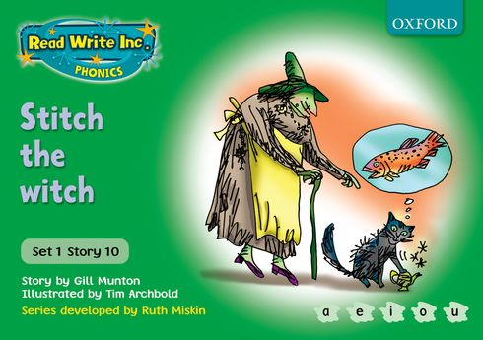
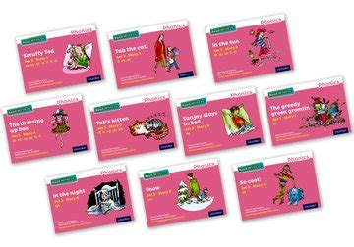
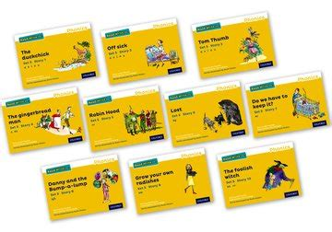
Decodable books
Made up of words using only the sets of sounds pupils have already been taught so they can decode every word.

Slide 24
Phonics Screening Check
Every Year 1 child in a mainstream, state-maintained school.
Read 40 words.
Mix of real words and ‘pseudo’ (or ‘alien’) words.
Pass threshold subject to change each year (but has been the same since 2013).

Slide 26
‘Pseudo’ words
Or ‘Alien words’
Meaningless combinations of graphemes designed to test children’s ability to blend words (and not ‘read’).

Slide 28
Problems with SSP
English does not have a transparent phonetic code. There are 44 phoneme but only 26 letters.
Some letters make different sounds in different words. Others combine into digraphs (2 sounds) or trigraphs (3 sounds).

Slide 29
Think about ‘i’
shrimp
smile
high
snail
eight
Now think of your own example letter that can be read in different ways.
)

Slide 30
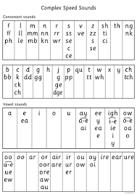
This is a sounds chart from Read Write Inc.
Notice how there 2, 3, 4 or even 5 ways of making the same sound?!
f
eigh

Slide 31
Problems with SSP
Letters are also used inconsistently.
‘f’ in ‘of’ (v)
‘a’ in ‘always’ (or)
‘au’ in ‘because’ (o)
These words are undecodable (or ‘red’ words).

Slide 32
Problems with SSP
Recent research has suggested that the over-emphasis on decoding has disadvantaged children.
Wyse and Bradbury (2021):
Over-emphasis on phonics at the expense of comprehension has damaged reading attainment.
Calls for ‘reconciliation.’

Slide 33
Oxford Reading Tree
Instead of using controlled sounds, uses controlled vocabulary instead.

Slide 34
Phonics and technical practice
‘Systematic synthetic phonics.’
The Rose review (2006) emphasized the need for ‘fidelity to the programme.’
This meant that phonics schemes adopted must be followed carefully and consistently.

Slide 35
Phonics
Controversy on how best to teach children – lots of press attention
Should it be letter-to-sound correspondences so that children can learn to sound out words (systematic phonics) or whole language the meanings of written words in stories?
Synthetic systematic phonics is widely used in the UK context – teaches children the sounds in isolation and then to put them together
Reading schemes and interest in reading (Levy, 2011).

Slide 36
Schooled literacy
Define the term ‘schooled literacy’
Thinking about your practice, what are the benefits of a ‘schooled approach’ to literacy?
What are the drawbacks?

Slide 37
Discussion
Guardian article: https://www.theguardian.com/education/2022/jan/19/focus-on-phonics-to-teach-reading-is-failing-children-says-landmark-study
What are your experiences of working with reading schemes and phonics?
What are the advantages and disadvantages of reading schemes and phonics?
Do you agree or disagree with the guardian article from Task 2? State your reason

Slide 38
Bringing back to last week
LITERACY: Communicational practices that include script, talk and other modal forms (Pahl and Rowsell, 2020).
‘Literacy is about seeing, disrupting, hoping, knowing, creating and making….Literacy is too important to be reduced to a set of skills’ (Pahl and Rowsell, 2020, pp.2-4)

Slide 39
Learning outcomes
Apply an understanding of the relationship between literacy and everyday life.
Enhance traditional theorisations of language and literacy with disruptive contemporary issues
Take an holistic approach to literacy teaching and learning in practice

Slide 40
Next week
Decentering schooled approaches
Martin
Martenscroft

